Slide 1

Applied Data Mining
Week 3
Dr. Farshid Keivanian
Semester 1, 2025

Slide 2
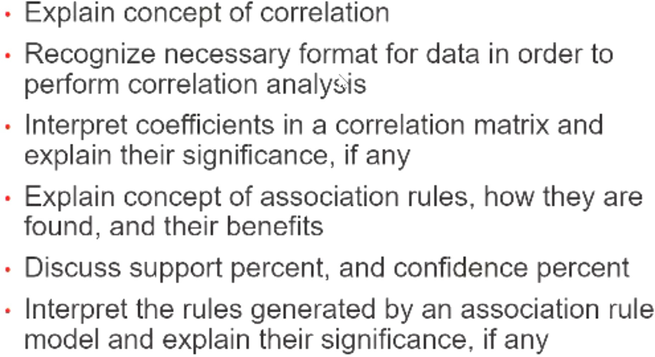
What are we doing this week?
Faculty of Business and Law | Peter Faber Business School

Slide 3
Correlation Analysis
What is Correlation Analysis?
Correlation measures the strength and direction of a relationship between two numerical variables.
It helps identify patterns in data where one variable changes in relation to another.
Correlation coefficients range from -1 (perfect negative correlation) to 1 (perfect positive correlation), with 0 indicating no correlation.
Faculty of Business and Law | Peter Faber Business School

Slide 4
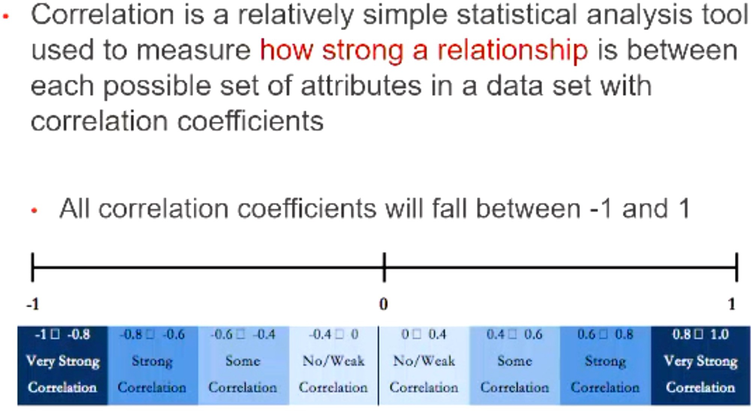
Correlation Analysis
The correlation coefficient ranges from -1 to 1:
Positive correlation (0 to 1): As one variable increases, the other also increases.
Negative correlation (-1 to 0): As one variable increases, the other decreases.
Zero correlation: No relationship between the variables.
Faculty of Business and Law | Peter Faber Business School

Slide 5
Correlation Analysis
Types of Correlation and Strength
Correlation Coefficient | Strength | Example in Australia
-1 to -0.8 | Very Strong Negative | Higher temperature → Lower demand for heating oil in Melbourne.
-0.8 to -0.6 | Strong Negative | Increased rainfall → Decreased drought severity in Queensland.
Faculty of Business and Law | Peter Faber Business School

Slide 6
Correlation Analysis
Types of Correlation and Strength
Correlation Coefficient | Strength | Example in Australia
-0.6 to -0.4 | Moderate Negative | More work-from-home setups → Lower public transport usage in Sydney.
-0.4 to 0 | Weak/No Correlation | Daily coffee consumption → Fuel prices in Australia.
Faculty of Business and Law | Peter Faber Business School

Slide 7
Correlation Analysis
Types of Correlation and Strength
Correlation Coefficient | Strength | Example in Australia
0 to 0.4 | Weak Positive | Higher university fees → Slight increase in online course enrollments.
0.4 to 0.6 | Moderate Positive | Higher temperatures → More air conditioner sales in Perth.
Faculty of Business and Law | Peter Faber Business School

Slide 8
Correlation Analysis
Types of Correlation and Strength
Correlation Coefficient | Strength | Example in Australia
0.6 to 0.8 | Strong Positive | Higher fuel prices → Increased interest in electric cars in Australia.
0.8 to 1 | Very Strong Positive | Increased advertising → Higher product sales in Australian markets.
Faculty of Business and Law | Peter Faber Business School

Slide 9
Correlation Analysis
Examples:
Housing Prices vs. Interest Rates – A negative correlation exists, as higher interest rates often reduce housing demand.
Temperature vs. Energy Consumption – In hotter months, electricity consumption increases due to air conditioning use.
Education vs. Salary – Higher levels of education often correlate with higher salaries in the Australian job market.
Faculty of Business and Law | Peter Faber Business School

Slide 10
Correlation Analysis
How to Use Correlation in Real-World Analysis?
Understand relationships between variables in business, climate, and technology.
Predict trends (e.g., high petrol prices leading to increased public transport use).
Avoid incorrect assumptions—correlation does not imply causation.
Key Takeaway: Correlation helps identify relationships in data, but it is not proof of cause and effect!
Faculty of Business and Law | Peter Faber Business School

Slide 11
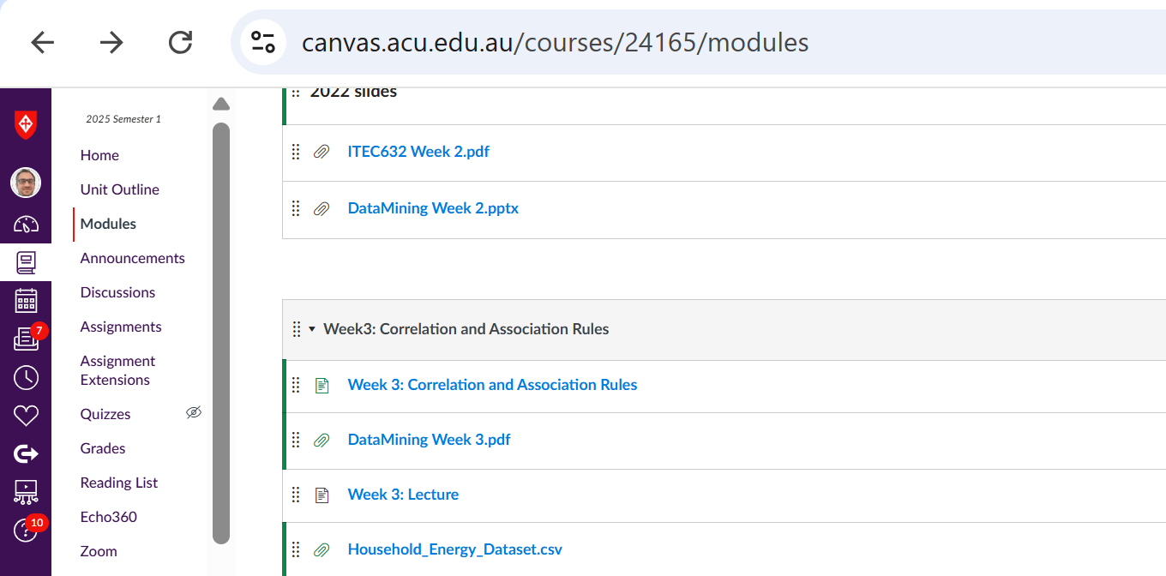
RapidMiner Problem Solving
Problem: Use RapidMiner to analyze the correlation between household energy consumption and insulation quality. The Dataset is available on Canvas. You can Download it.
Faculty of Business and Law | Peter Faber Business School

Slide 12
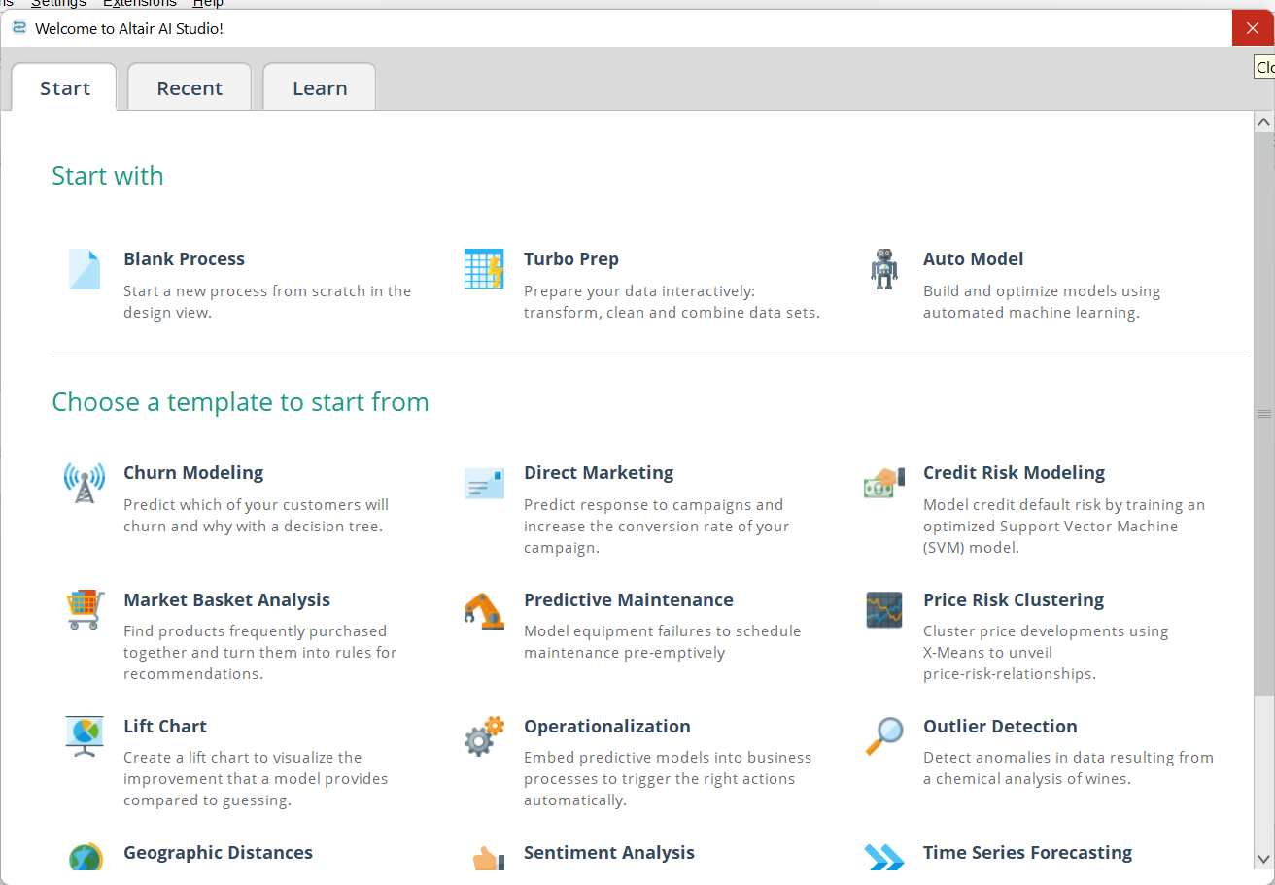
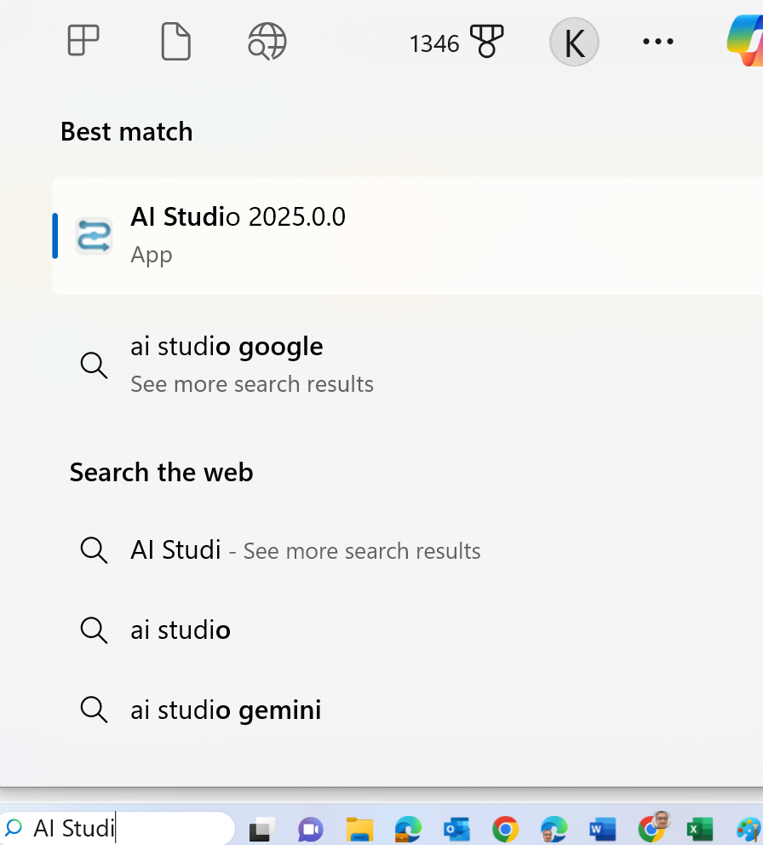
RapidMiner Problem Solving
Step-by-Step Instructions
Run AI Studio 2025
Select Blank Process
Faculty of Business and Law | Peter Faber Business School

Slide 13
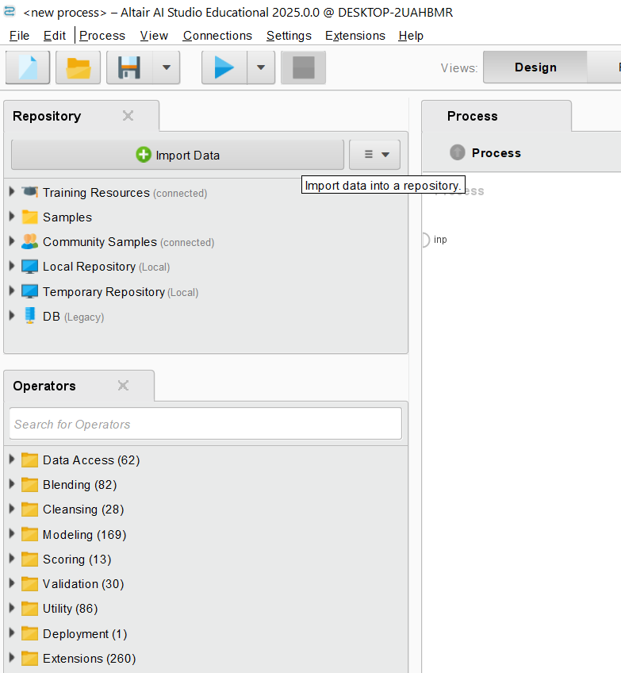
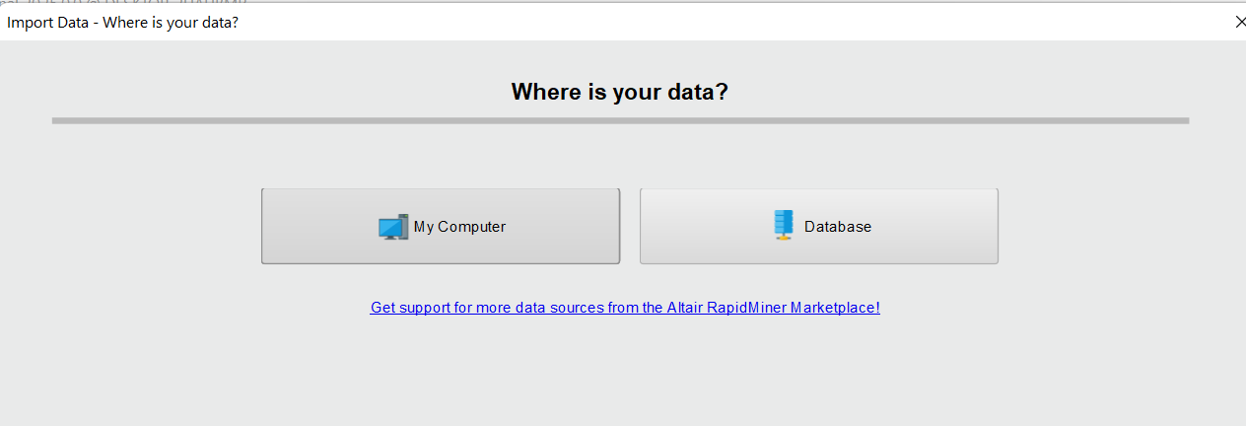
RapidMiner Problem Solving
Load Data
Click on Import Data in the Repository panel
Upload the Australian dataset on household energy use (Household_Energy_Dataset.csv). You might find this Panel when you click on Result View
Faculty of Business and Law | Peter Faber Business School

Slide 14
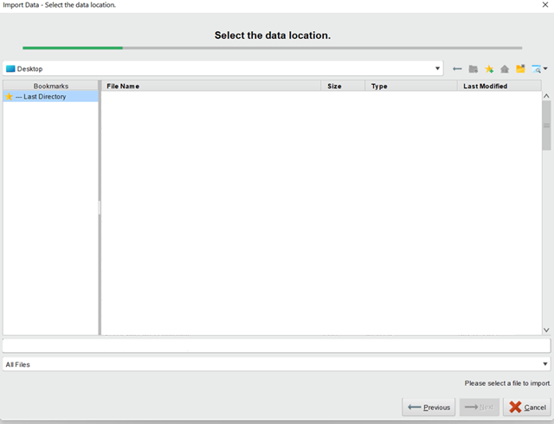
RapidMiner Problem Solving
Load Data
Enter the Path folder to find it (e.g., D:\ACU\ITEC325_NLic_Applied Data Mining)
Faculty of Business and Law | Peter Faber Business School

Slide 15
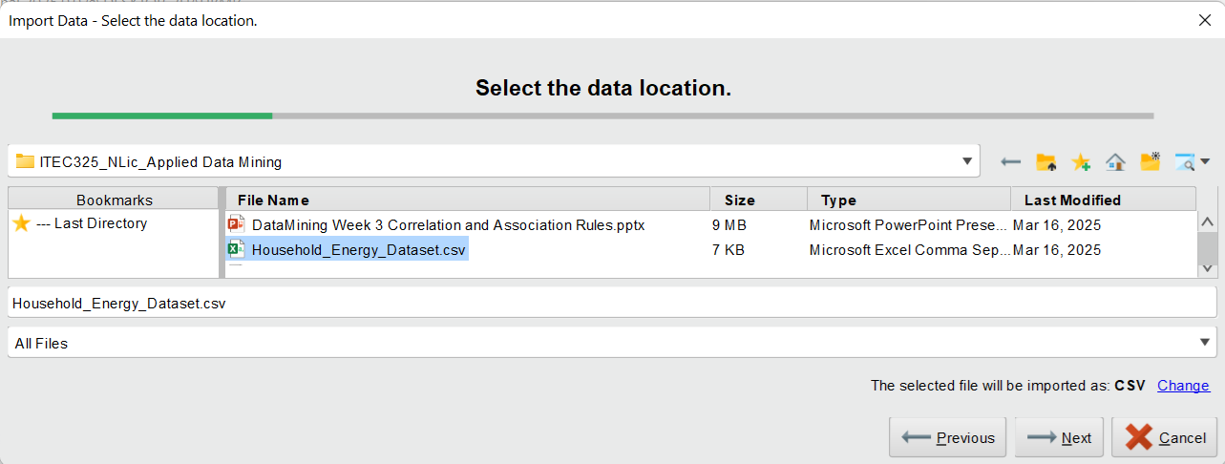
RapidMiner Problem Solving
Load Data
Click on the Dataset and Next
Faculty of Business and Law | Peter Faber Business School

Slide 16
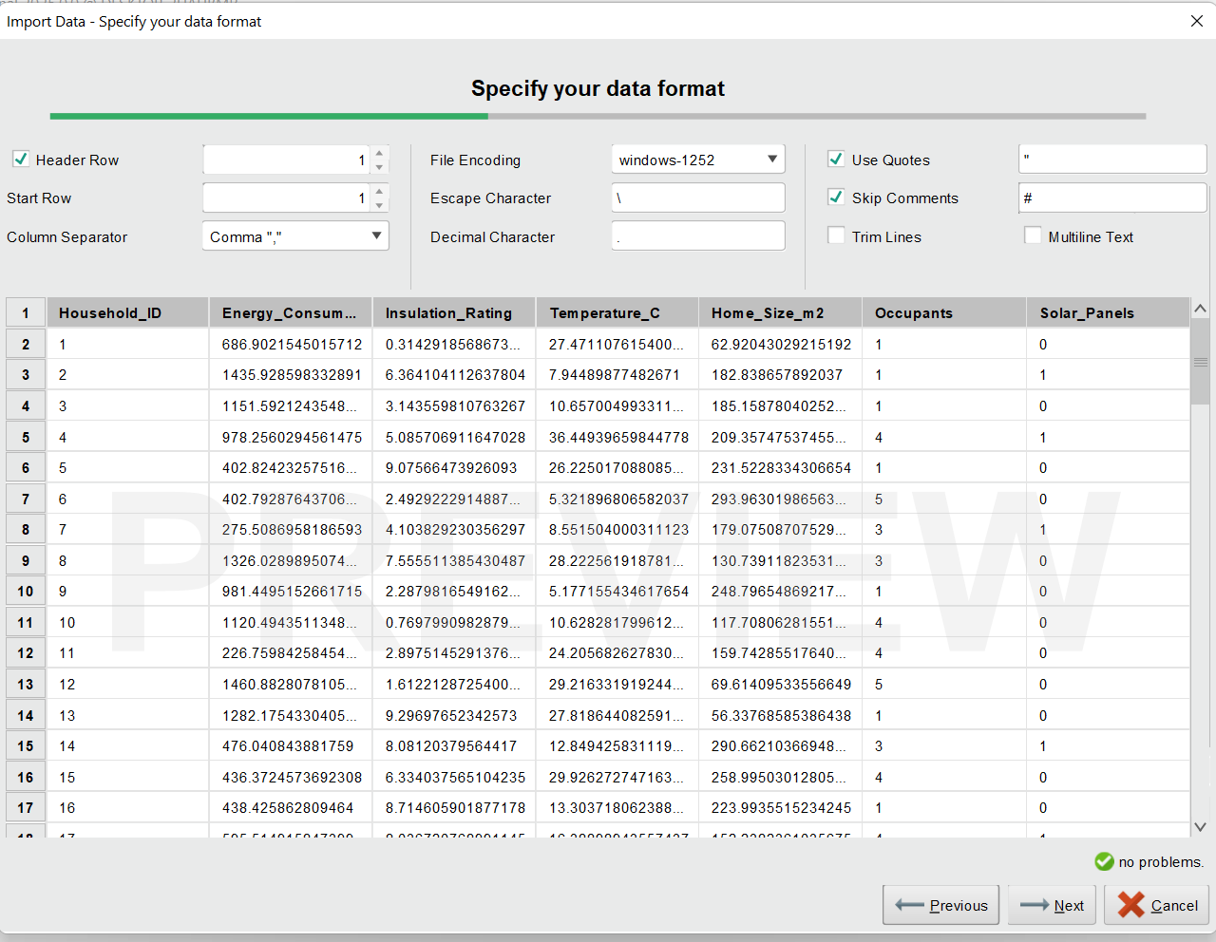
RapidMiner Problem Solving
The imported dataset contains key attributes such as energy consumption, insulation rating, temperature, home size, number of occupants, and solar panel installation, essential for analyzing household energy efficiency in Australia.
Faculty of Business and Law | Peter Faber Business School

Slide 17
RapidMiner Problem Solving
The imported dataset contains key attributes such as energy consumption, insulation rating, temperature, home size, number of occupants, and solar panel installation, essential for analyzing household energy efficiency in Australia.
Click Next
Faculty of Business and Law | Peter Faber Business School

Slide 18
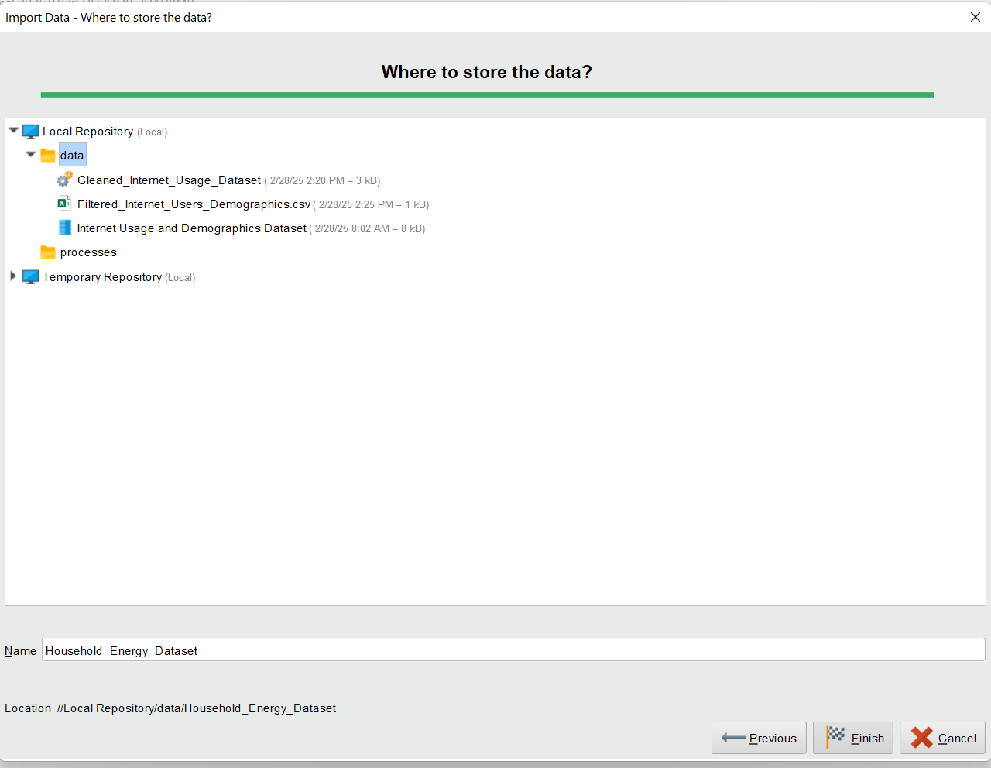
RapidMiner Problem Solving
Where to Store Data?
Choose Local Repository
Click on Finish
Faculty of Business and Law | Peter Faber Business School

Slide 19
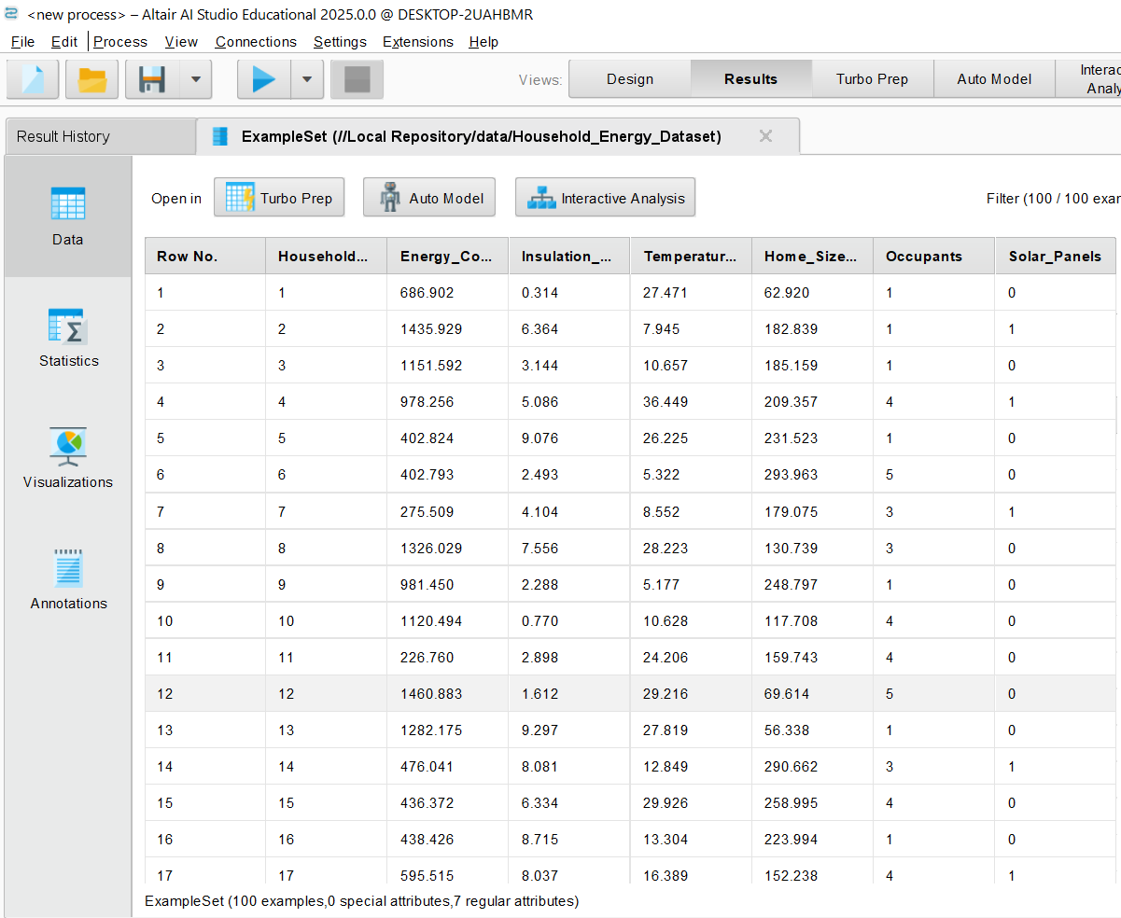
RapidMiner Problem Solving
We will see this
Click on Design View
Faculty of Business and Law | Peter Faber Business School

Slide 20
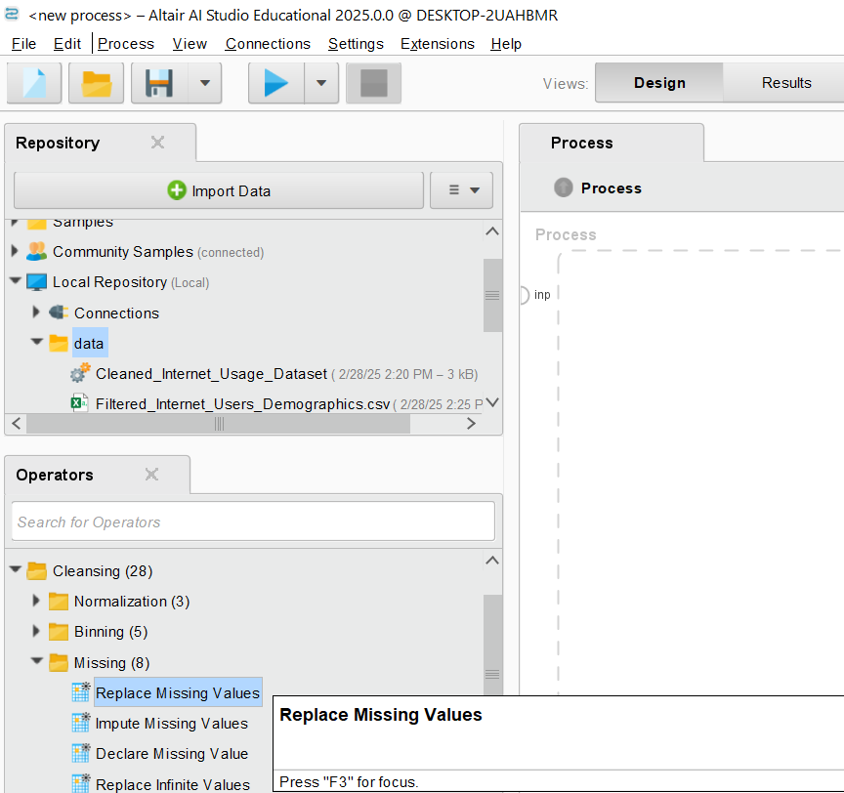
RapidMiner Problem Solving
3. Preprocess Data
Check for missing values:
Go to Operators → Cleansing → Replace Missing Values.
Drag and Drop it in the Process Panel
Faculty of Business and Law | Peter Faber Business School

Slide 21
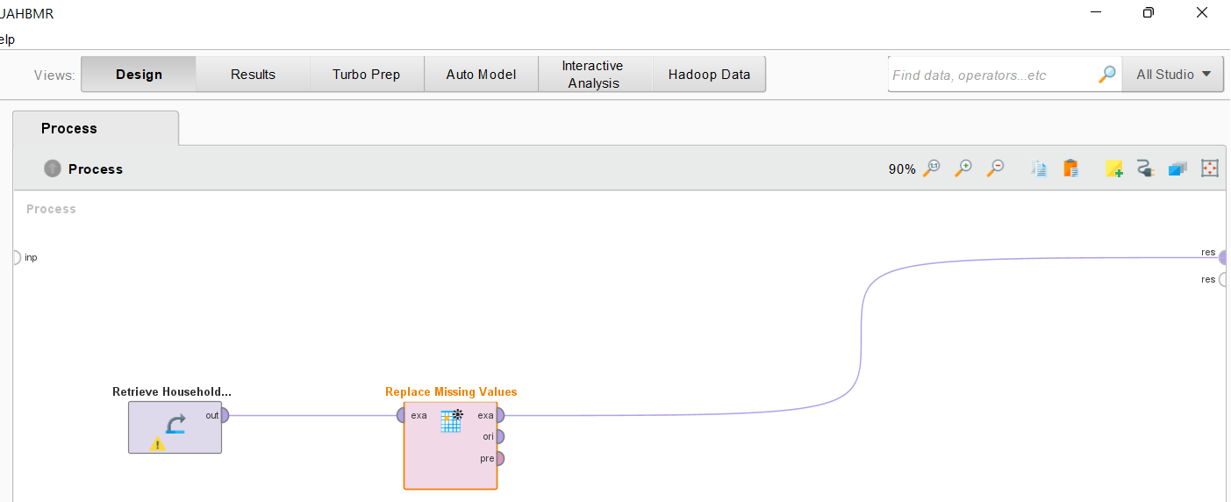
RapidMiner Problem Solving
Drag and Drop the Household Energy dataset into Process Panel
Connect the dataset to Replace Missing Value.
Faculty of Business and Law | Peter Faber Business School

Slide 22
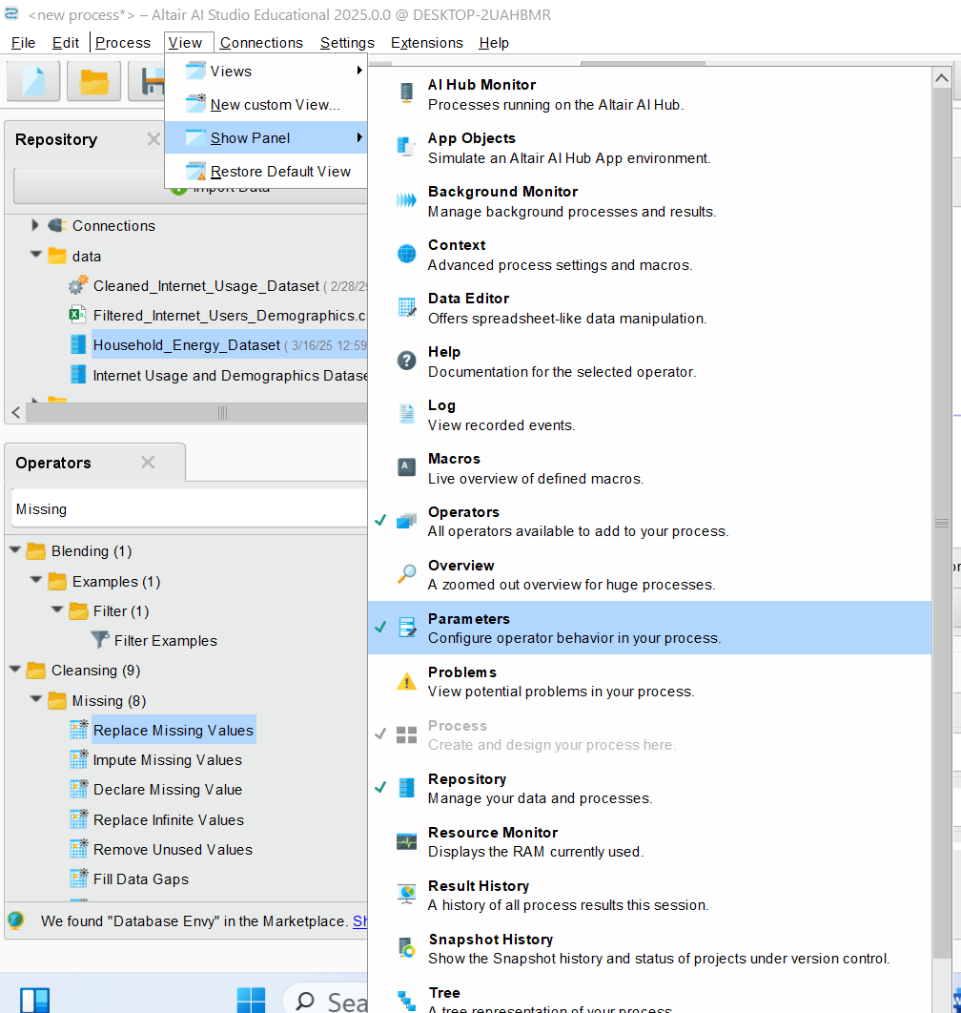
RapidMiner Problem Solving
Make Sure View >> Show Panel >> Parameters is ticked like here
Faculty of Business and Law | Peter Faber Business School

Slide 23
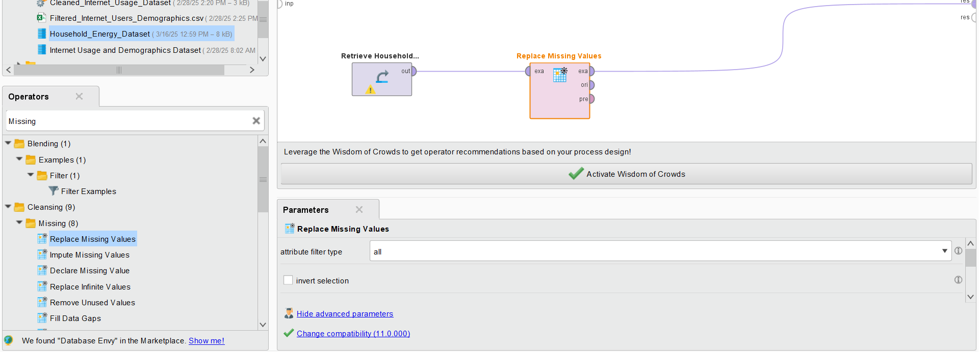
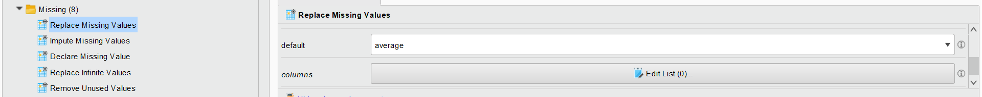
RapidMiner Problem Solving
Configure settings (e.g., replace missing all values with the mean).
Faculty of Business and Law | Peter Faber Business School

Slide 24
RapidMiner Problem Solving
Configure settings (e.g., replace missing all values with the mean).
Faculty of Business and Law | Peter Faber Business School

Slide 25
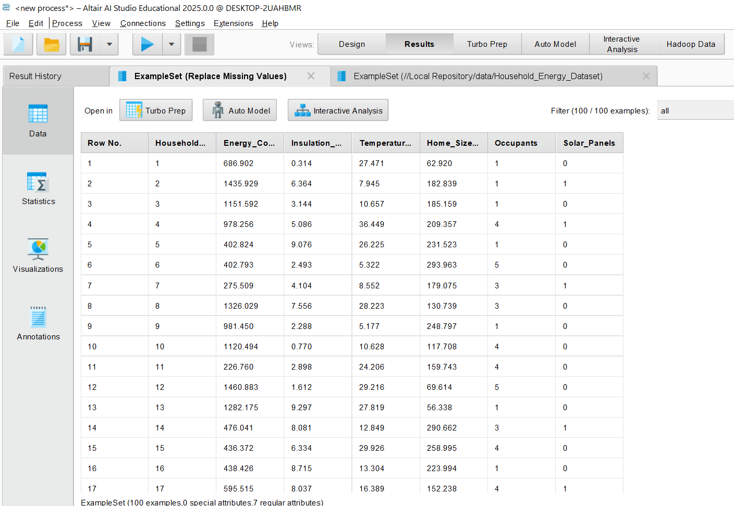
RapidMiner Problem Solving
Now, we ensure the data is cleaned and we can proceed with correlation analysis step.
Faculty of Business and Law | Peter Faber Business School

Slide 26
RapidMiner Problem Solving
4. Select Relevant Attributes
Since we only need key attributes for correlation analysis (e.g., Energy_Consumption, Insulation_Rating, Temperature, Home_Size), filter out unnecessary attributes:
Faculty of Business and Law | Peter Faber Business School

Slide 27
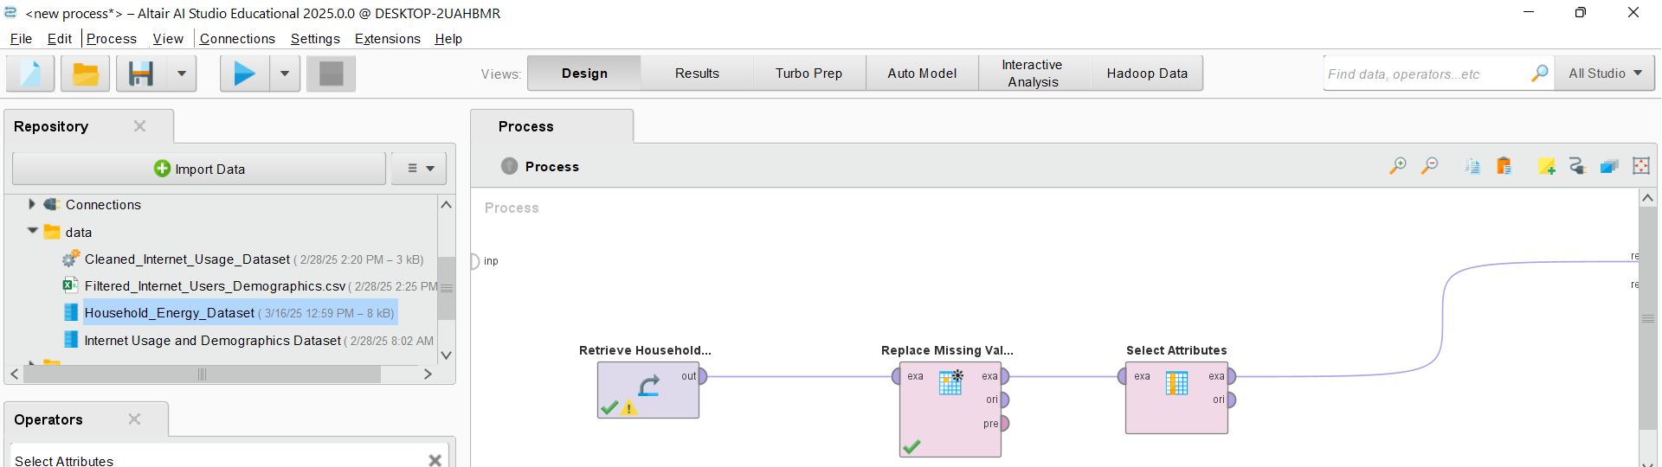
RapidMiner Problem Solving
In the Operators panel, search for Select Attributes.
Drag it into the Process panel after the Replace Missing Values operator.
Connect the Replace Missing Values operator’s output to the Select Attributes operator.
Faculty of Business and Law | Peter Faber Business School

Slide 28
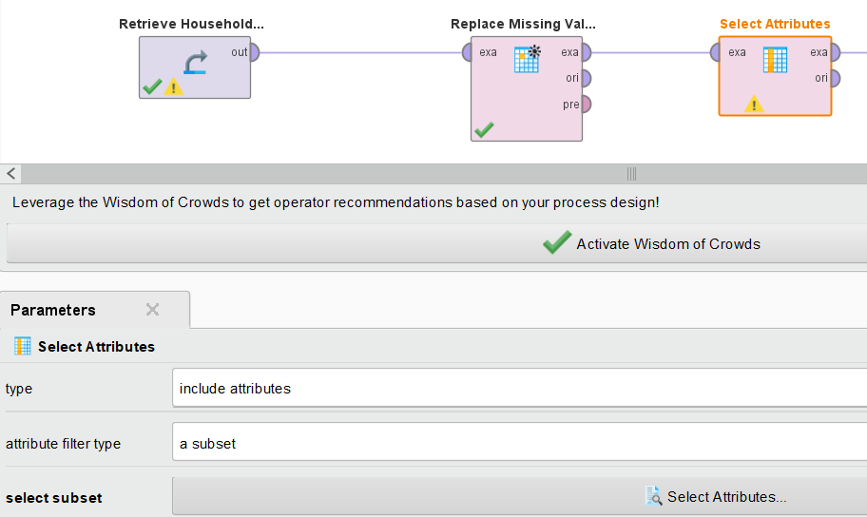
RapidMiner Problem Solving
Click the Select Attributes operator (Make sure View >> Show Pannel >> Parameters is ticked)
Choose these attributes (Attribute Filter Type >> Subset >> Select Attributes >> Hold Ctrl Key >> Select the Attributes)
Energy_Consumption
Insulation_Rating
Temperature
Home_Size
Faculty of Business and Law | Peter Faber Business School

Slide 29
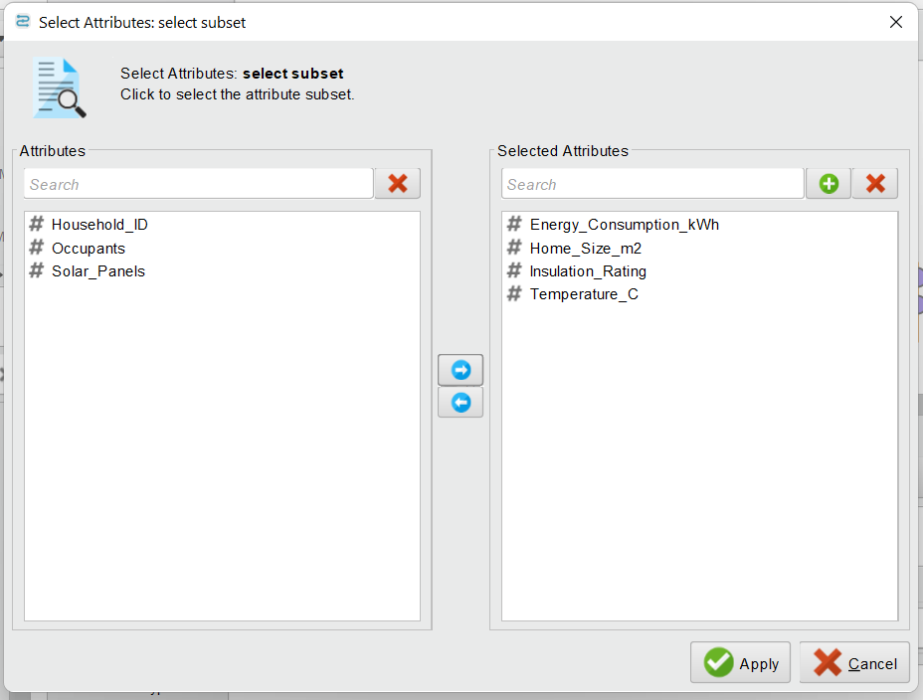
RapidMiner Problem Solving
Click Apply and Return to Process.
Faculty of Business and Law | Peter Faber Business School

Slide 30
RapidMiner Problem Solving
We select Energy_Consumption, Insulation_Rating, Temperature, and Home_Size among other attributes because they are the most relevant for analyzing how household energy use is affected by different factors. Here's why:
Energy_Consumption (kWh) → Target Variable
This is the key variable we want to analyze. It represents the amount of energy used by the household.
Faculty of Business and Law | Peter Faber Business School

Slide 31
RapidMiner Problem Solving
Insulation_Rating (Scale 1-10) → Efficiency Factor
Insulation affects how much heating/cooling is needed. A higher insulation rating should reduce energy consumption.
Temperature (°C) → Environmental Influence
Outside temperature affects heating and cooling needs. We expect colder temperatures to increase energy use and warmer temperatures to reduce it.
Faculty of Business and Law | Peter Faber Business School

Slide 32
RapidMiner Problem Solving
Home_Size (m²) → Space Factor
Larger homes typically require more energy to heat or cool, making this an important factor in energy analysis.
Faculty of Business and Law | Peter Faber Business School

Slide 33
RapidMiner Problem Solving
Why Exclude Other Attributes?
Occupants: While the number of people impacts energy use, it may not have a direct linear relationship.
Solar_Panels: Having solar panels affects energy generation, not necessarily consumption.
By focusing on these four key attributes, we can identify strong correlations and patterns in how energy is consumed based on insulation, temperature, and home size.
Faculty of Business and Law | Peter Faber Business School

Slide 34
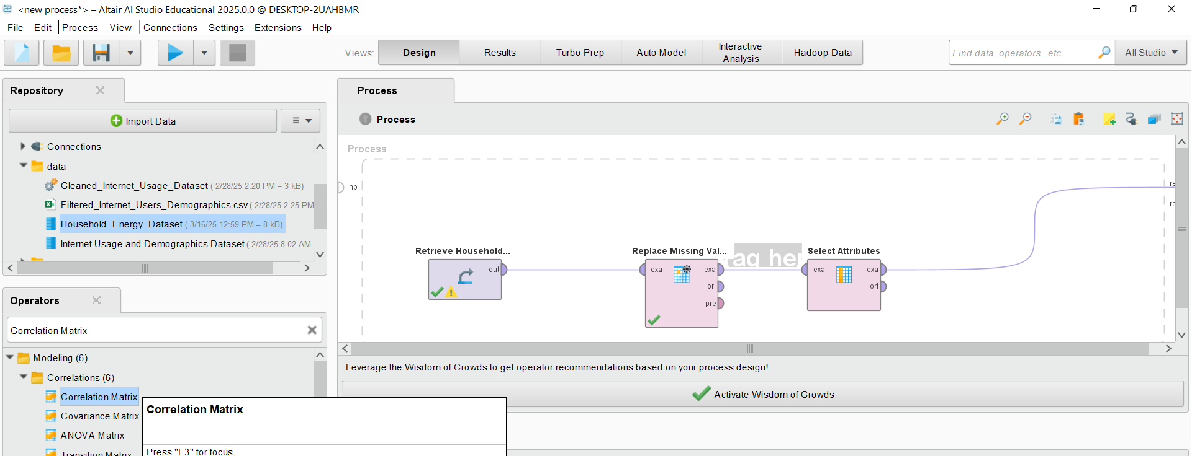
RapidMiner Problem Solving
5. Apply Correlation Matrix
In the Operators panel, search for Correlation Matrix under Correlation.
Drag the Correlation Matrix operator into the Process panel.
Faculty of Business and Law | Peter Faber Business School

Slide 35
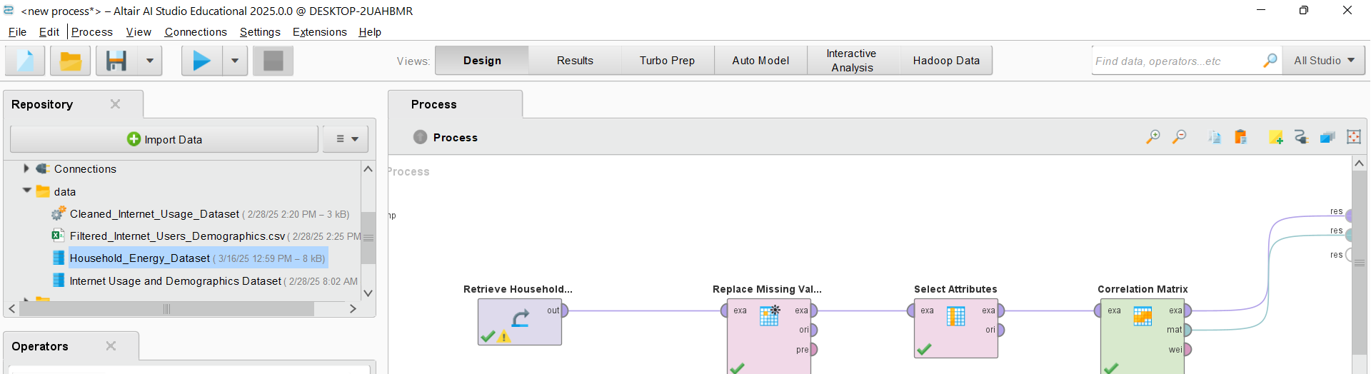
RapidMiner Problem Solving
Connect the Select Attributes operator’s output to the Correlation Matrix operator.
Connect all the Correlation Matrix operator’s outputs to the Result (res) outputs.
Click Run (play button) to execute the process.
Faculty of Business and Law | Peter Faber Business School

Slide 36
RapidMiner Problem Solving
6. Interpret Correlation Results
After running the process, go to the Results tab.
The correlation matrix will display values ranging from -1 to 1, where:
1 (or close to 1) = Strong positive correlation
-1 (or close to -1) = Strong negative correlation
0 = No correlation
Identify which attributes have strong positive or negative correlations.
Faculty of Business and Law | Peter Faber Business School

Slide 37
RapidMiner Problem Solving
6. Interpret Correlation Results
For example:
If Insulation_Rating has a negative correlation with Energy_Consumption, it means that better insulation leads to lower energy usage.
Faculty of Business and Law | Peter Faber Business School

Slide 38
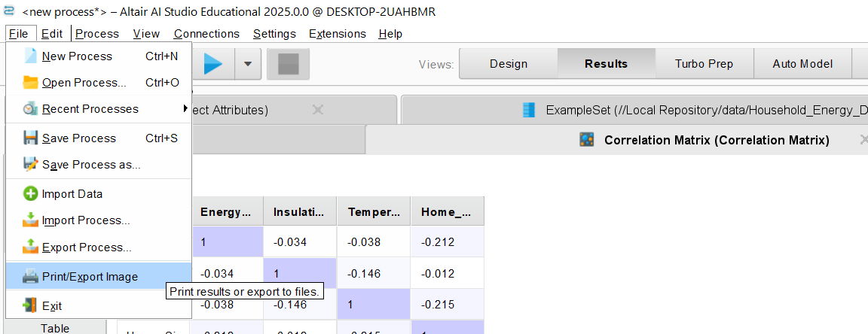
RapidMiner Problem Solving
7. Save and Export Results
Click Export in the Results tab to save the correlation matrix as a CSV file. (You can
Easily share the results with others.
Use the data in Excel or other analysis tools for further study.
Keep a record of your findings for future reference.)
Faculty of Business and Law | Peter Faber Business School

Slide 39
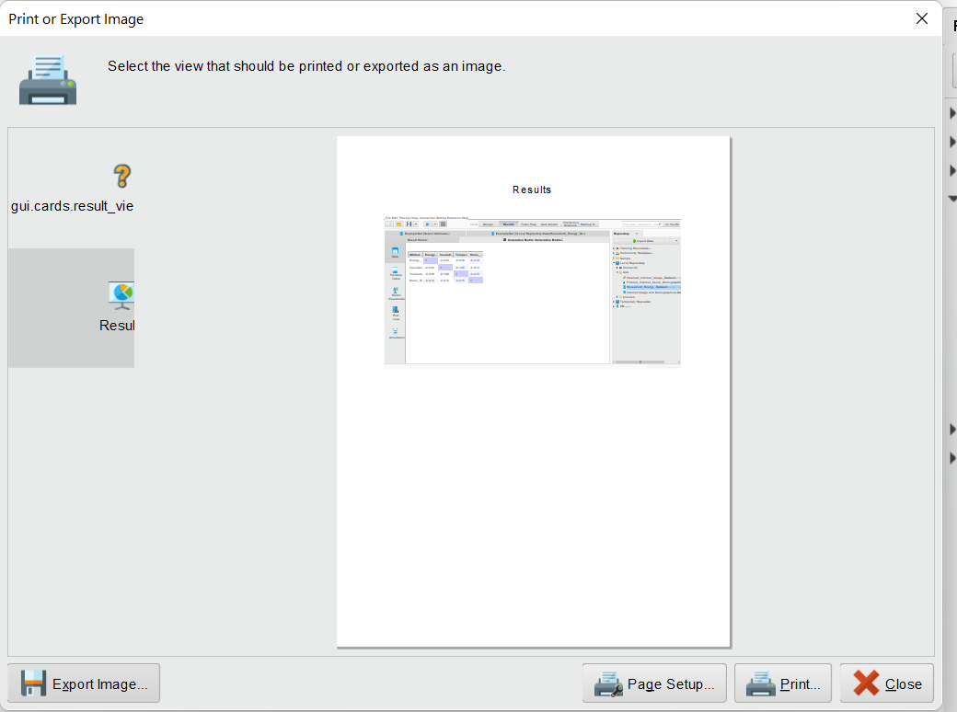
RapidMiner Problem Solving
7. Save and Export Results
Click on Export Image
Enter a name
Choose Image Type
Faculty of Business and Law | Peter Faber Business School

Slide 40
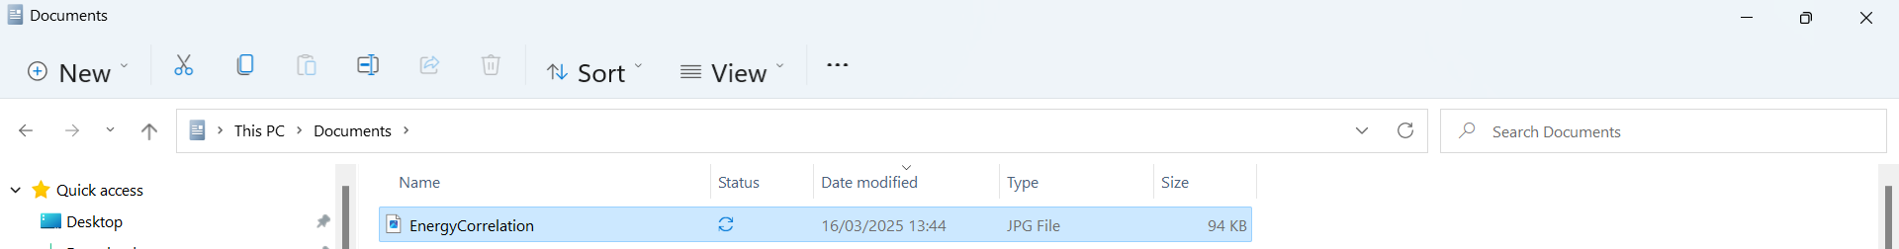
RapidMiner Problem Solving
7. Save and Export Results
Click on Export Image
Enter a name
Choose Image Type
Faculty of Business and Law | Peter Faber Business School

Slide 41
RapidMiner Problem Solving
8. Discuss the findings in terms of energy efficiency in Australia.
Faculty of Business and Law | Peter Faber Business School

Slide 42
Understanding the Correlation Matrix in Household Energy Use
In this scenario, we are analyzing:
Energy Consumption (kWh) – The amount of electricity used by a household.
Insulation Rating – A measure of how well a home retains heat or cool air.
Temperature (°C) – The average temperature of the household environment.
Home Size (m²) – The total area of the house.
Faculty of Business and Law | Peter Faber Business School

Slide 43
Understanding the Correlation Matrix in Household Energy Use
The values in the correlation matrix range from -1 to 1:
1 means a perfect positive relationship (as one increases, the other increases).
-1 means a perfect negative relationship (as one increases, the other decreases).
0 means no relationship.
Faculty of Business and Law | Peter Faber Business School

Slide 44
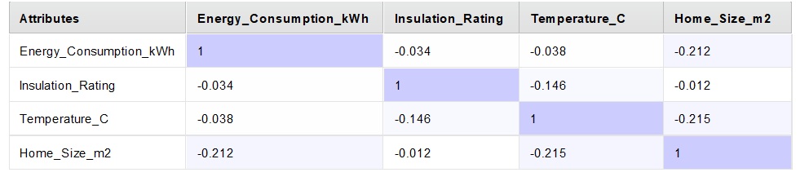
Understanding the Correlation Matrix in Household Energy Use
What Do These Numbers Mean?
Energy Consumption vs. Insulation Rating (-0.034)
Weak negative correlation → Insulation does not strongly impact energy use.
Possible reason: Households may be using different energy-efficient appliances, making insulation less important.
Faculty of Business and Law | Peter Faber Business School

Slide 45
Understanding the Correlation Matrix in Household Energy Use
2. Energy Consumption vs. Temperature (-0.038)
Weak negative correlation → Cooler temperatures slightly increase energy use, but the effect is minimal.
Example: Some people use heaters more in winter, but other factors like household habits matter too.
Faculty of Business and Law | Peter Faber Business School

Slide 46
Understanding the Correlation Matrix in Household Energy Use
3. Energy Consumption vs. Home Size (-0.212)
Weak negative correlation → Larger homes use energy differently.
Possible reason: Bigger homes may have better insulation, modern appliances, or different energy use patterns.
Faculty of Business and Law | Peter Faber Business School

Slide 47
Understanding the Correlation Matrix in Household Energy Use
4. Insulation Rating vs. Temperature (-0.146)
Weak negative correlation → Houses in colder areas tend to have better insulation.
Real-world example: Homes in Melbourne may have better insulation than those in Brisbane due to the cooler climate.
Faculty of Business and Law | Peter Faber Business School

Slide 48
Understanding the Correlation Matrix in Household Energy Use
5. Temperature vs. Home Size (-0.215)
Weak negative correlation → Larger homes are slightly cooler on average.
Why? Better air circulation, or these homes may have energy-efficient cooling systems.
Faculty of Business and Law | Peter Faber Business School

Slide 49
Why Does This Matter in Australia?
Insulation is not the only factor affecting energy use → The weak correlation (-0.034) suggests that while insulation helps, appliances, household habits, and home design may play a bigger role in energy efficiency.
Faculty of Business and Law | Peter Faber Business School

Slide 50
Why Does This Matter in Australia?
Different climates lead to different energy needs → Sydney (milder climate) relies more on cooling, while Canberra (cold winters) needs more heating. This affects how insulation and energy use are related.
Faculty of Business and Law | Peter Faber Business School

Slide 51
Why Does This Matter in Australia?
Bigger homes do not always mean higher energy bills → Energy-efficient homes (e.g., passive solar designs) can use less energy per square meter compared to poorly insulated smaller homes.
Faculty of Business and Law | Peter Faber Business School

Slide 52
Research Discussion Questions
Based on the correlation values, do you think insulation should be a priority in reducing energy bills? Why or why not?
Not necessarily. The weak correlation suggests other factors (like energy-efficient appliances, solar panels, and user behavior) might have a bigger impact.
Faculty of Business and Law | Peter Faber Business School

Slide 53
Research Discussion Questions
Why do you think temperature and home size have a negative correlation? Can you think of real-world examples?
Larger homes may have better ventilation, higher ceilings, or energy-efficient materials that help maintain temperature naturally.
Example: A well-designed house in Melbourne might stay cool in summer without much air conditioning.
Faculty of Business and Law | Peter Faber Business School

Slide 54
Research Discussion Questions
What other factors (besides the four in our dataset) could affect energy consumption?
Appliance efficiency (e.g., star-rated refrigerators, heat pumps).
Solar panels and battery storage (common in Australia).
Time-of-use electricity pricing (affects when people use energy).
Building orientation (north-facing homes get more sunlight).
Faculty of Business and Law | Peter Faber Business School

Slide 55
Research Discussion Questions
If you were advising a homeowner in Melbourne vs. Brisbane, what energy-saving strategies would you suggest?
Melbourne (colder): Improve heating efficiency, invest in double-glazed windows, and use thermal curtains.
Brisbane (hotter): Use solar panels, install ceiling fans, and opt for light-colored roofing to reflect heat.
Faculty of Business and Law | Peter Faber Business School

Slide 56
Problem-Solving Task: Improve Energy Efficiency in an Australian Home
One change they should make (based on data):
Focus on home size and efficiency rather than insulation. Since home size has a weak negative correlation (-0.212) with energy consumption, investing in energy-efficient appliances and smart usage habits (e.g., LED lighting, efficient air conditioning) may have a bigger impact.
Faculty of Business and Law | Peter Faber Business School

Slide 57
Problem-Solving Task: Improve Energy Efficiency in an Australian Home
X One change that is probably not useful (based on data):
Insulation improvements alone won’t significantly reduce energy bills. The correlation (-0.034) is too weak to prove that insulation directly lowers electricity costs in Sydney’s climate.
Faculty of Business and Law | Peter Faber Business School

Slide 58
Problem-Solving Task: Improve Energy Efficiency in an Australian Home
One additional factor to study:
Appliance usage patterns. High-energy devices like heaters, air conditioners, and dryers could have a stronger influence on bills than insulation. Smart meters and usage tracking could help optimize consumption.
Faculty of Business and Law | Peter Faber Business School

Slide 59
Problem-Solving Task: Improve Energy Efficiency in an Australian Home
Presentation Tip:
Keep it practical! Focus on real-world applications like switching to solar energy, using off-peak electricity rates, and upgrading to energy-efficient appliances.
Faculty of Business and Law | Peter Faber Business School

Slide 60
Applying the Mutual Information Matrix
The Mutual Information Matrix helps measure how much information two attributes share. Unlike correlation, it detects non-linear relationships as well.
Faculty of Business and Law | Peter Faber Business School

Slide 61
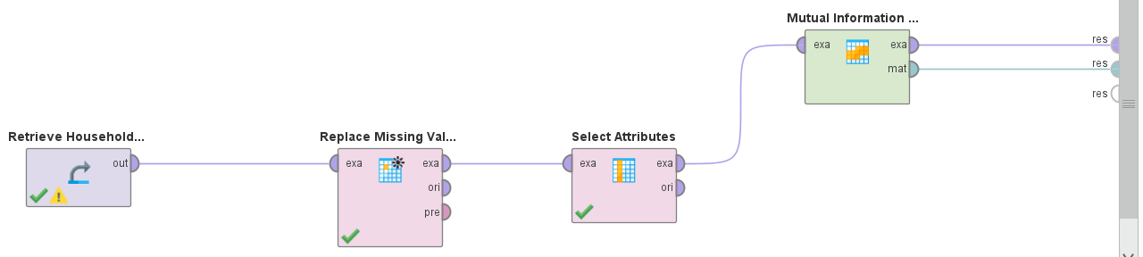
Applying the Mutual Information Matrix
Step 1: Add the Mutual Information Matrix Operator
In the Operators panel, search for "Mutual Information Matrix".
Drag the Mutual Information Matrix operator into the Process panel.
Place it after the "Select Attributes" operator.
Faculty of Business and Law | Peter Faber Business School

Slide 62
Applying the Mutual Information Matrix
Step 2: Connect the Operator
Connect the "exa" (example set) output of the Select Attributes operator to the "exa" input of the Mutual Information Matrix operator.
Connect the "mat" (matrix output) of the Mutual Information Matrix operator to the final output (res).
Faculty of Business and Law | Peter Faber Business School

Slide 63
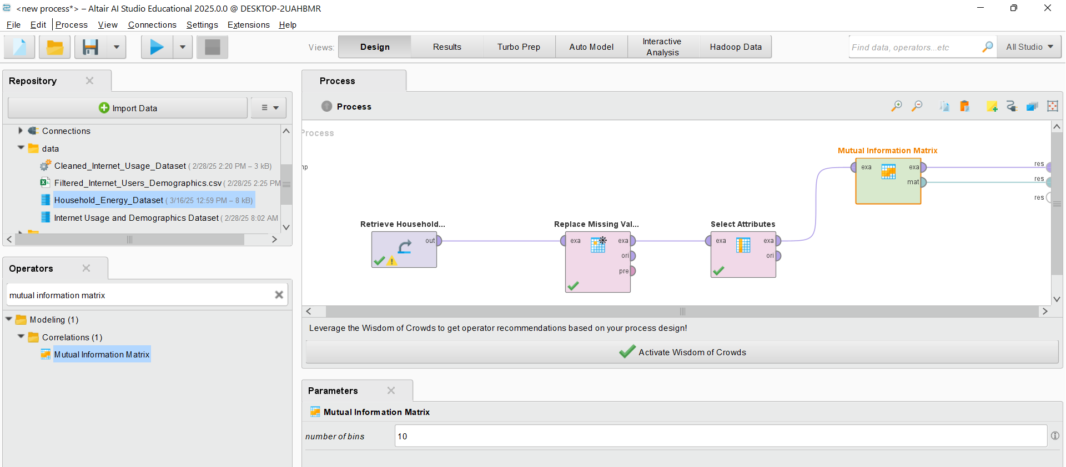
Applying the Mutual Information Matrix
Step 3: Configure the Operator
Click on the Mutual Information Matrix operator.
In the Parameters panel, check if the operator settings need any modifications. Usually, the default settings work fine.
Faculty of Business and Law | Peter Faber Business School

Slide 64
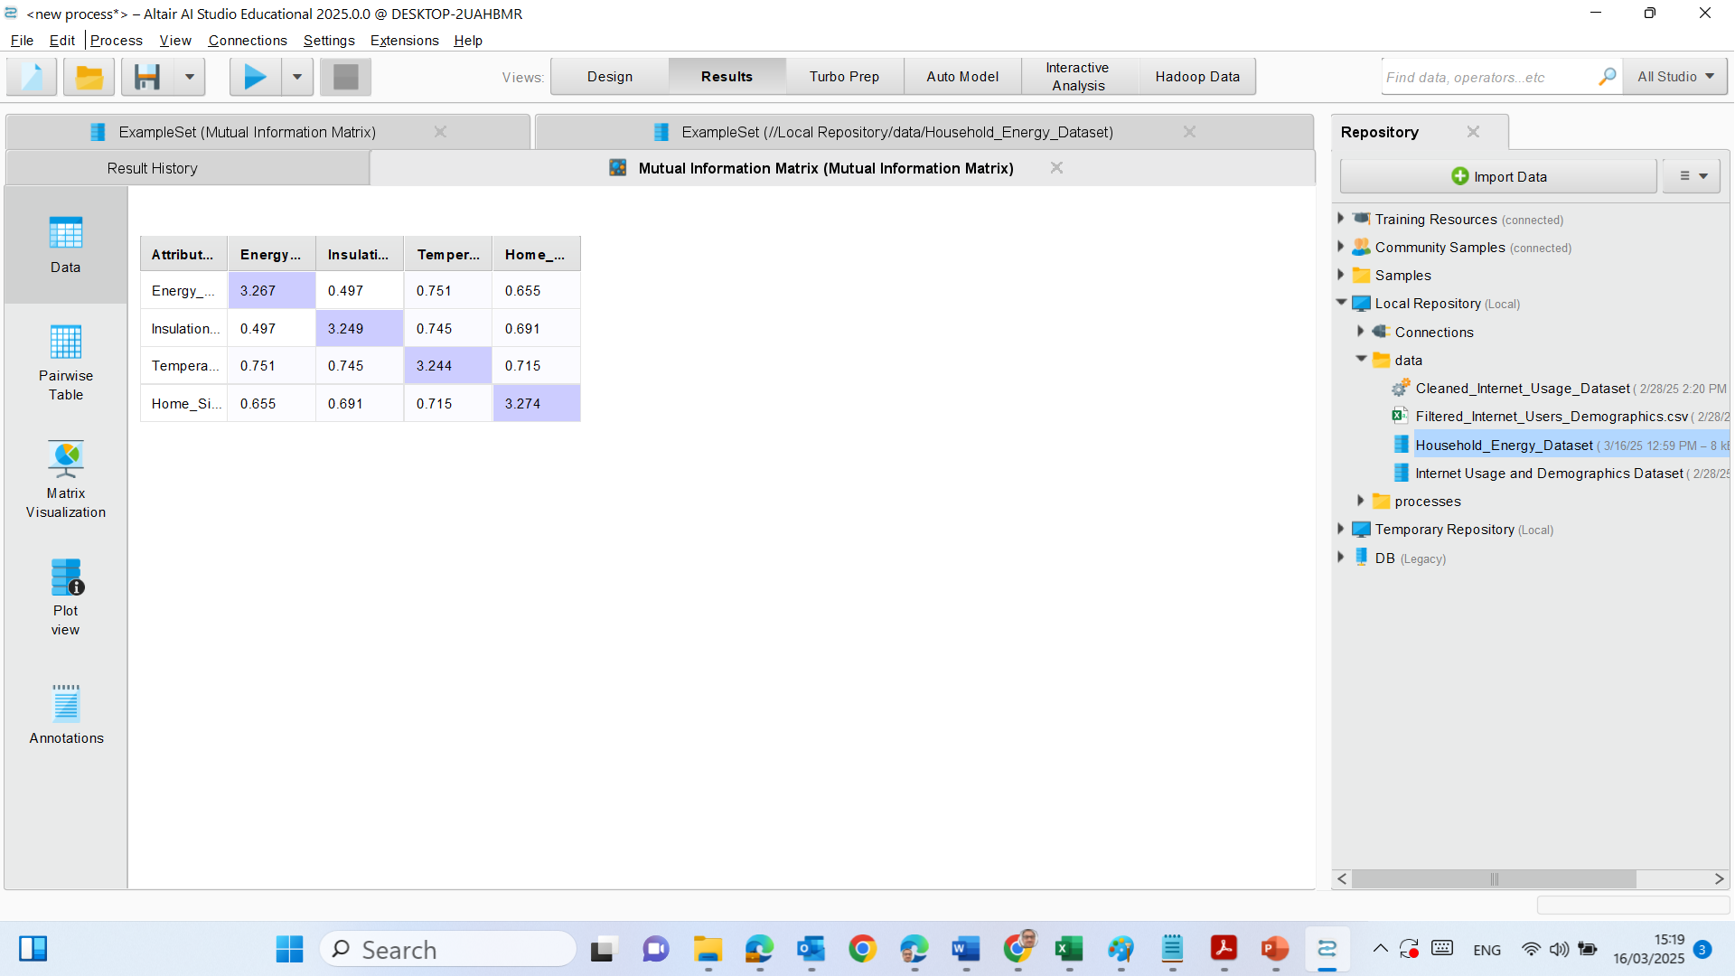
Applying the Mutual Information Matrix
Step 4: Run the Process
Click the Run (▶) button at the top.
Once the process completes, navigate to the Results tab.
Faculty of Business and Law | Peter Faber Business School

Slide 65
Step 5: Analyze the Results
In the Results tab, look for the Mutual Information Matrix table.
The values indicate how much information each attribute shares with the others.
Higher values = Stronger information dependency.
Lower values = Weaker relationship.
Faculty of Business and Law | Peter Faber Business School

Slide 66
Key Insights:
Energy Consumption & Temperature (0.751)
Strongest relationship with Energy Consumption.
This suggests that temperature changes affect energy usage, likely due to heating/cooling appliances.
Example: Households in Canberra use more energy for heating in winter.
Faculty of Business and Law | Peter Faber Business School

Slide 67
Energy Consumption & Home Size (0.655)
Moderate MI value, meaning home size has an impact on energy use.
However, the effect is not as strong as temperature.
Example: A large house may have better insulation, leading to lower energy use per square meter.
Faculty of Business and Law | Peter Faber Business School

Slide 68
3. Energy Consumption & Insulation Rating (0.497)
Weaker relationship than expected.
Why? Other factors (like appliances, household habits) may influence energy use more.
Example: A house in Sydney with good insulation still uses a lot of energy if the family uses air conditioning frequently.
Faculty of Business and Law | Peter Faber Business School

Slide 69
4. Temperature & Insulation Rating (0.745)
Higher mutual information, suggesting better-insulated houses tend to be in areas with specific temperature ranges.
Example: Houses in cold regions like Tasmania often have better insulation.
Faculty of Business and Law | Peter Faber Business School

Slide 70
5. Temperature & Home Size (0.715)
Larger homes tend to have a stronger relationship with temperature.
Possible reasons: More air circulation, energy-efficient designs.
Example: New energy-efficient homes in Melbourne suburbs.
Faculty of Business and Law | Peter Faber Business School

Slide 71
Why This Matters in Australia?
Weather drives energy use → Heating & cooling are the biggest contributors to household electricity bills.
Insulation helps but isn’t everything → Appliances and behavior matter.
Bigger homes can be more efficient → Smart designs reduce energy waste.
Faculty of Business and Law | Peter Faber Business School

Slide 72
Research Discussion Questions:
Which factor affects energy consumption the most in Australia? Why?
Why does mutual information between insulation and energy use seem lower than expected?
If a new home is being built in Brisbane vs. Hobart, what energy-saving advice would you give based on this data?
Faculty of Business and Law | Peter Faber Business School

Slide 73
Final Takeaway
Mutual Information helps reveal hidden relationships that correlation might miss.
Temperature & energy consumption are highly connected.
Energy efficiency isn’t just about insulation—behavior and technology matter too.
Faculty of Business and Law | Peter Faber Business School

Slide 74
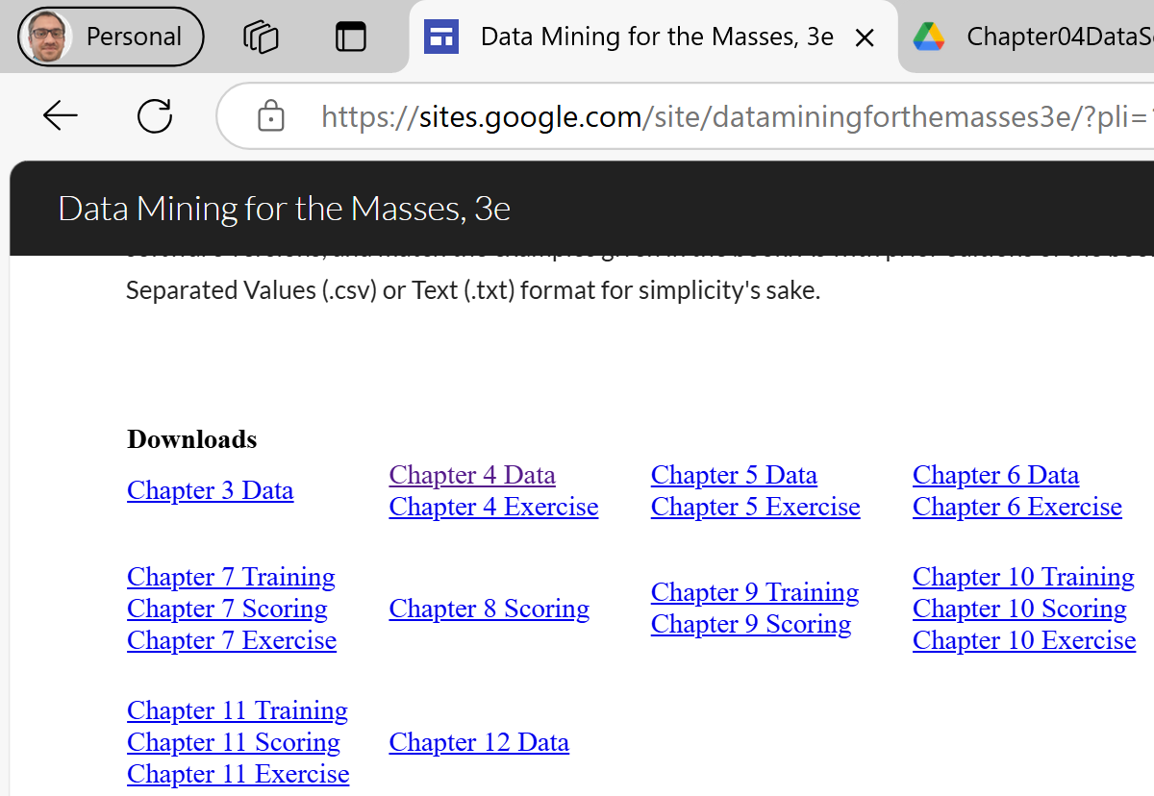
Hands-on Activity – Chapter 4 Dataset
https://sites.google.com/site/dataminingforthemasses3e/?pli=1
Download the Dataset
Understand the Attributes
Import CSV file
Explore if there is Missing Values
Add Correlation Matrix
Analyse Correlation Coefficients
Apply mutual information matrix operator

Slide 75
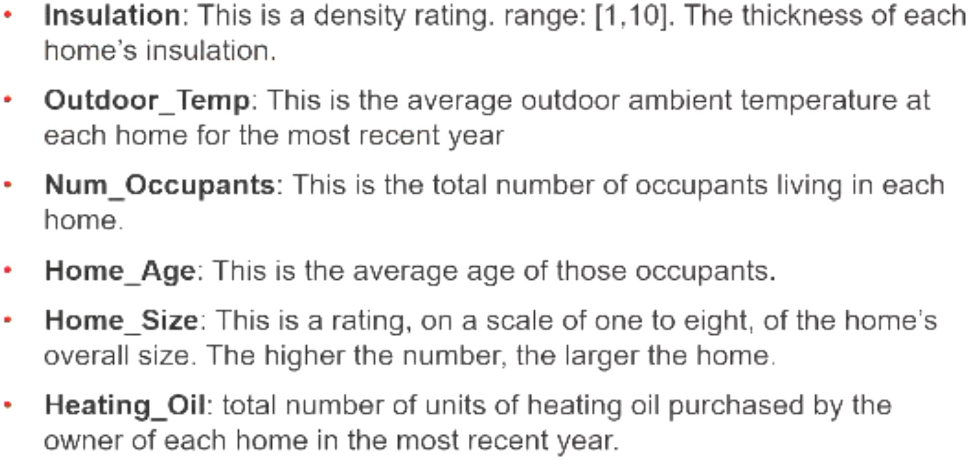
Data Understanding

Slide 76
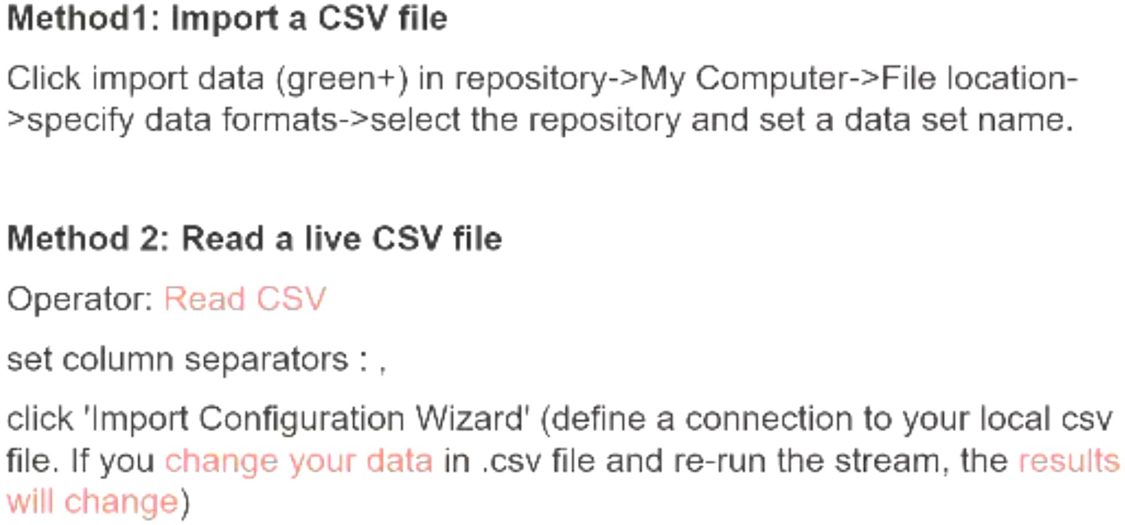
Reading a CSV File

Slide 77
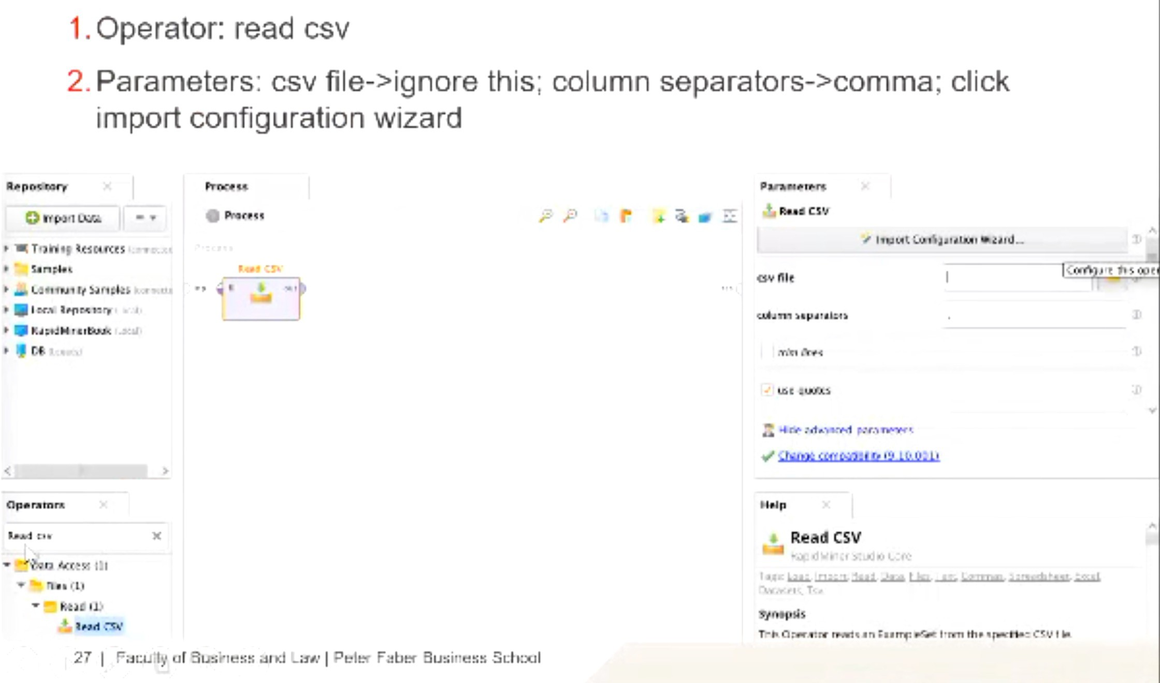
Read a Live CSV File

Slide 78
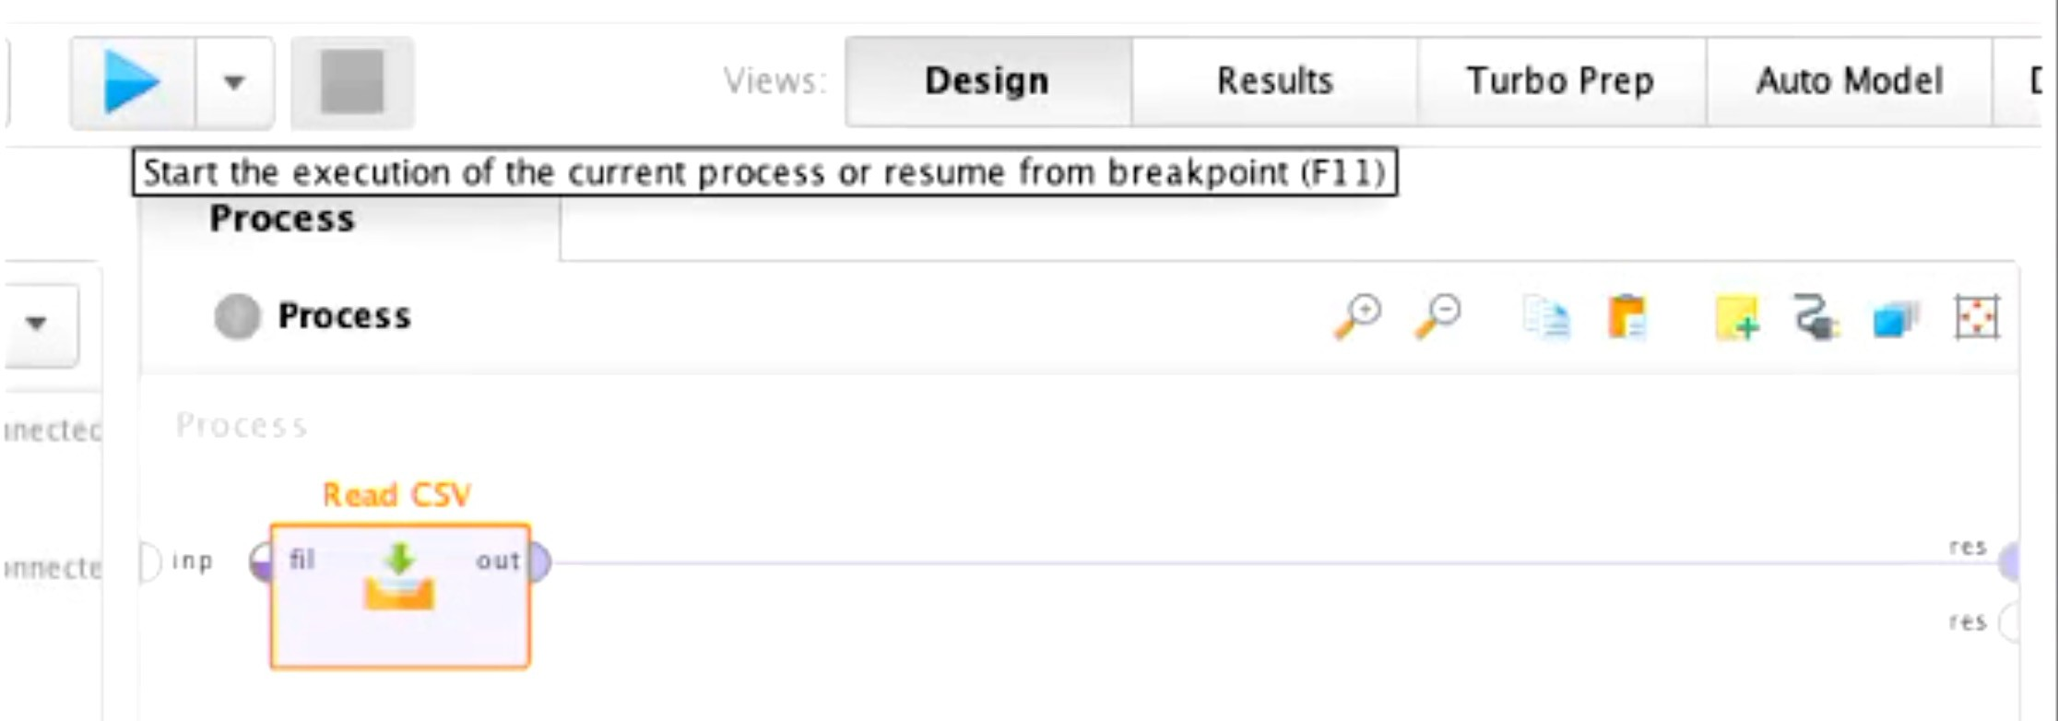
Run to examine the Dataset

Slide 79
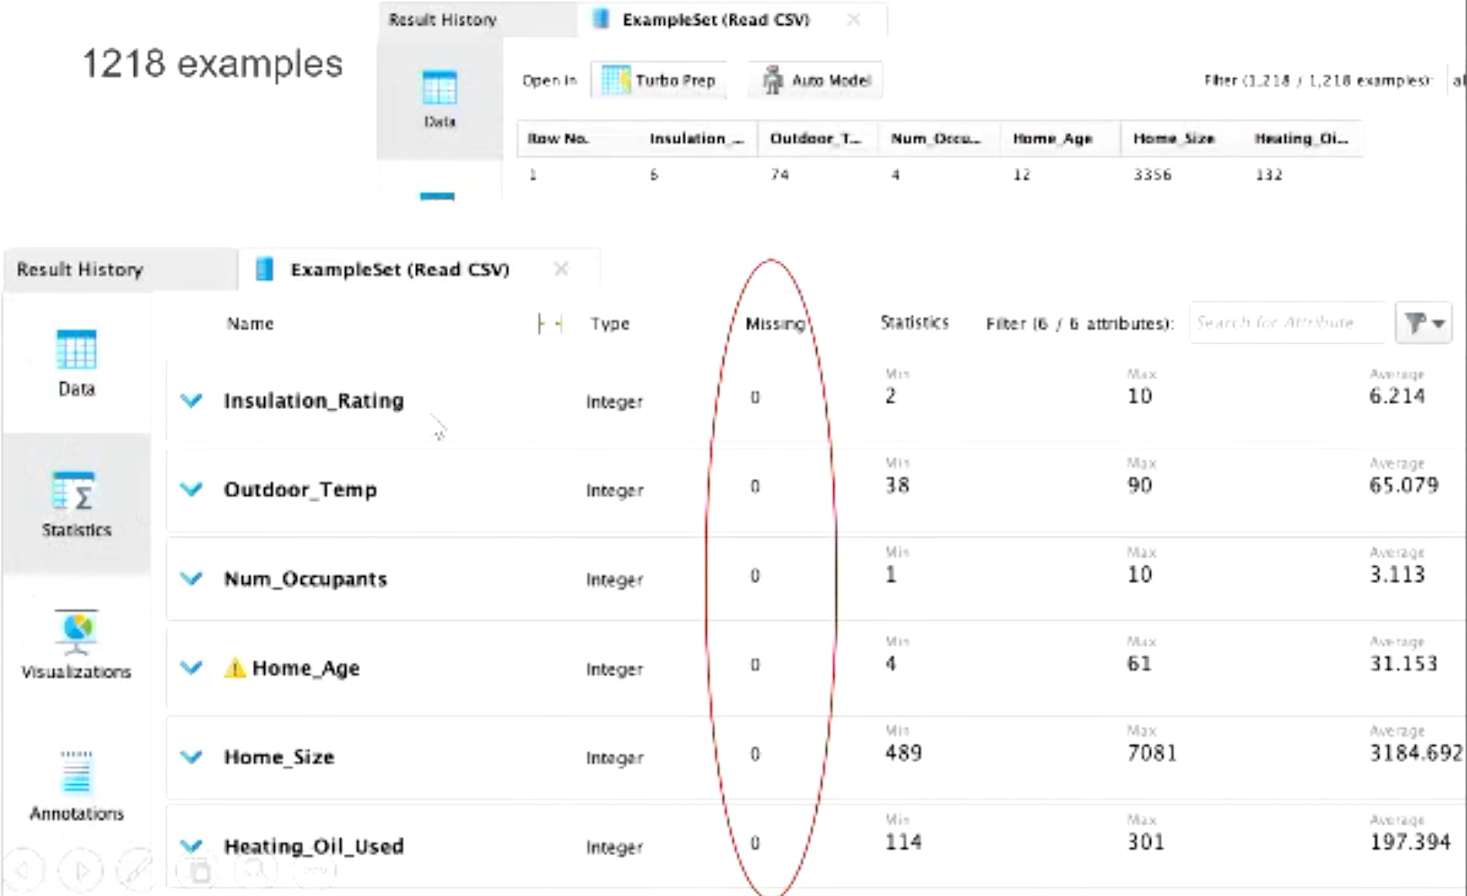
Data/Statistics

Slide 80
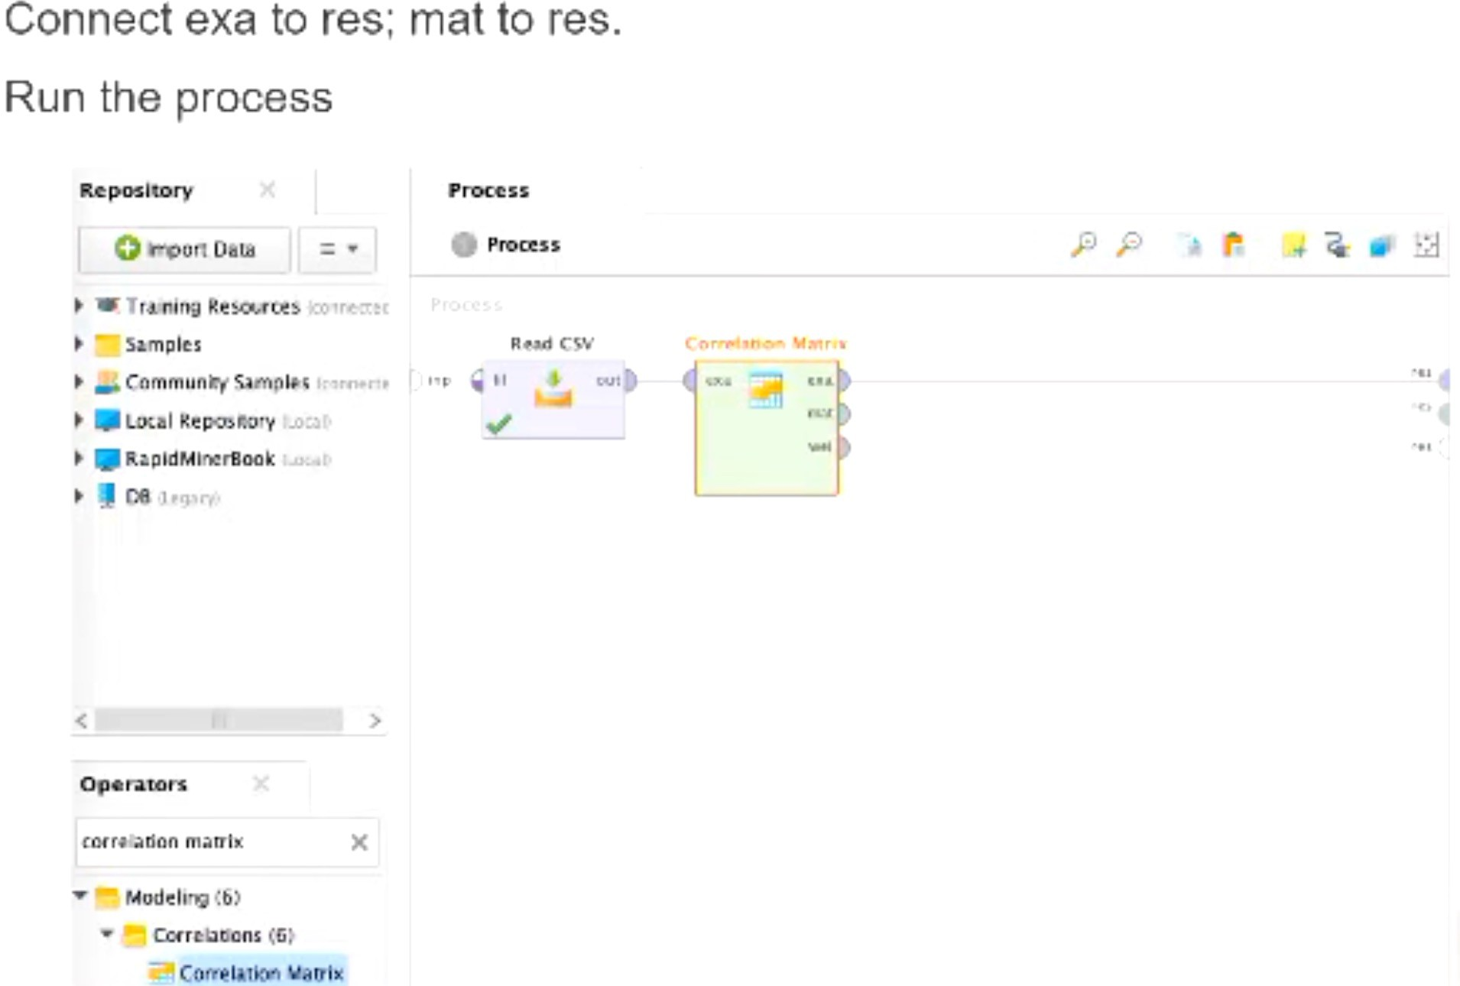
Add Operator: Correlation Matrix

Slide 81
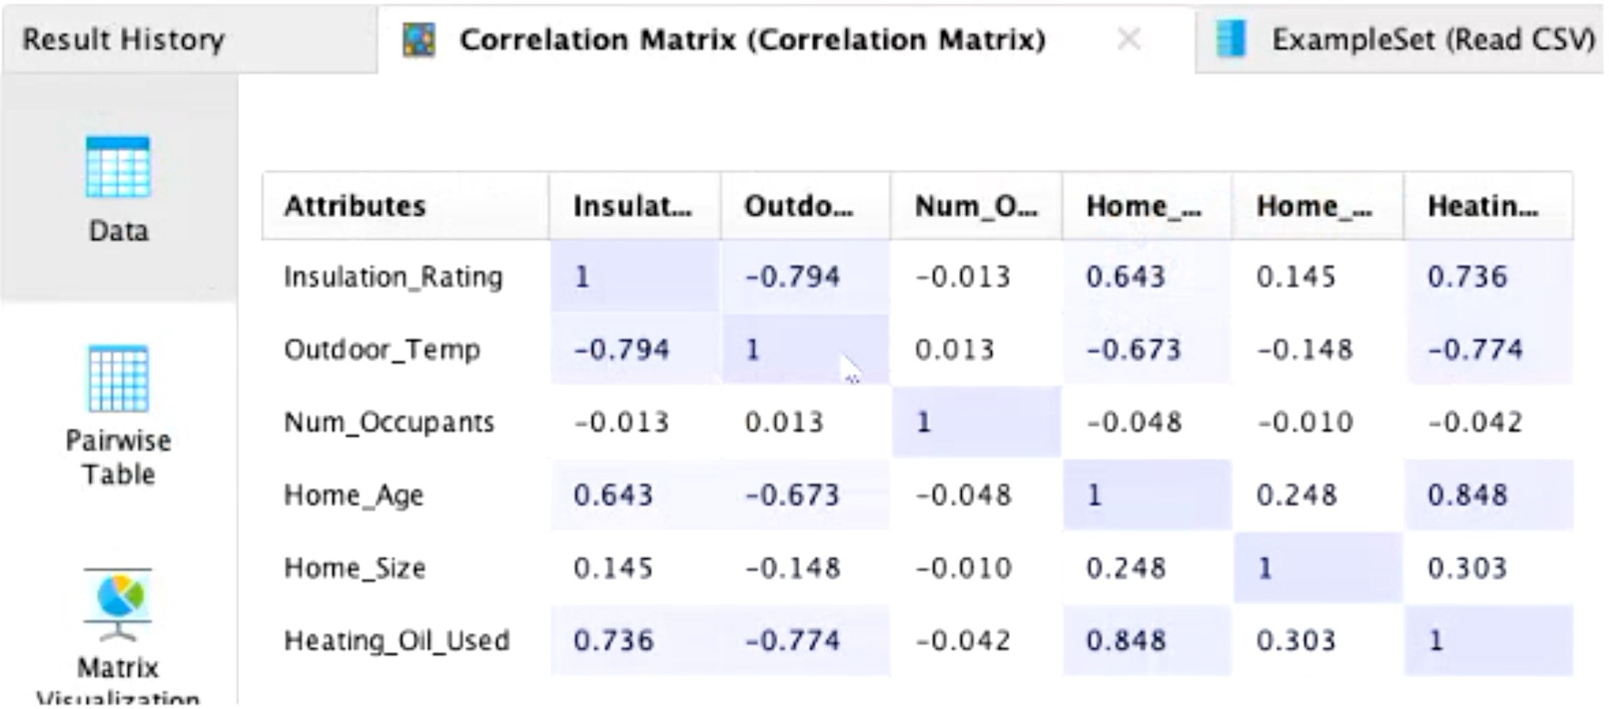
Results of Correlation Matrix

Slide 82
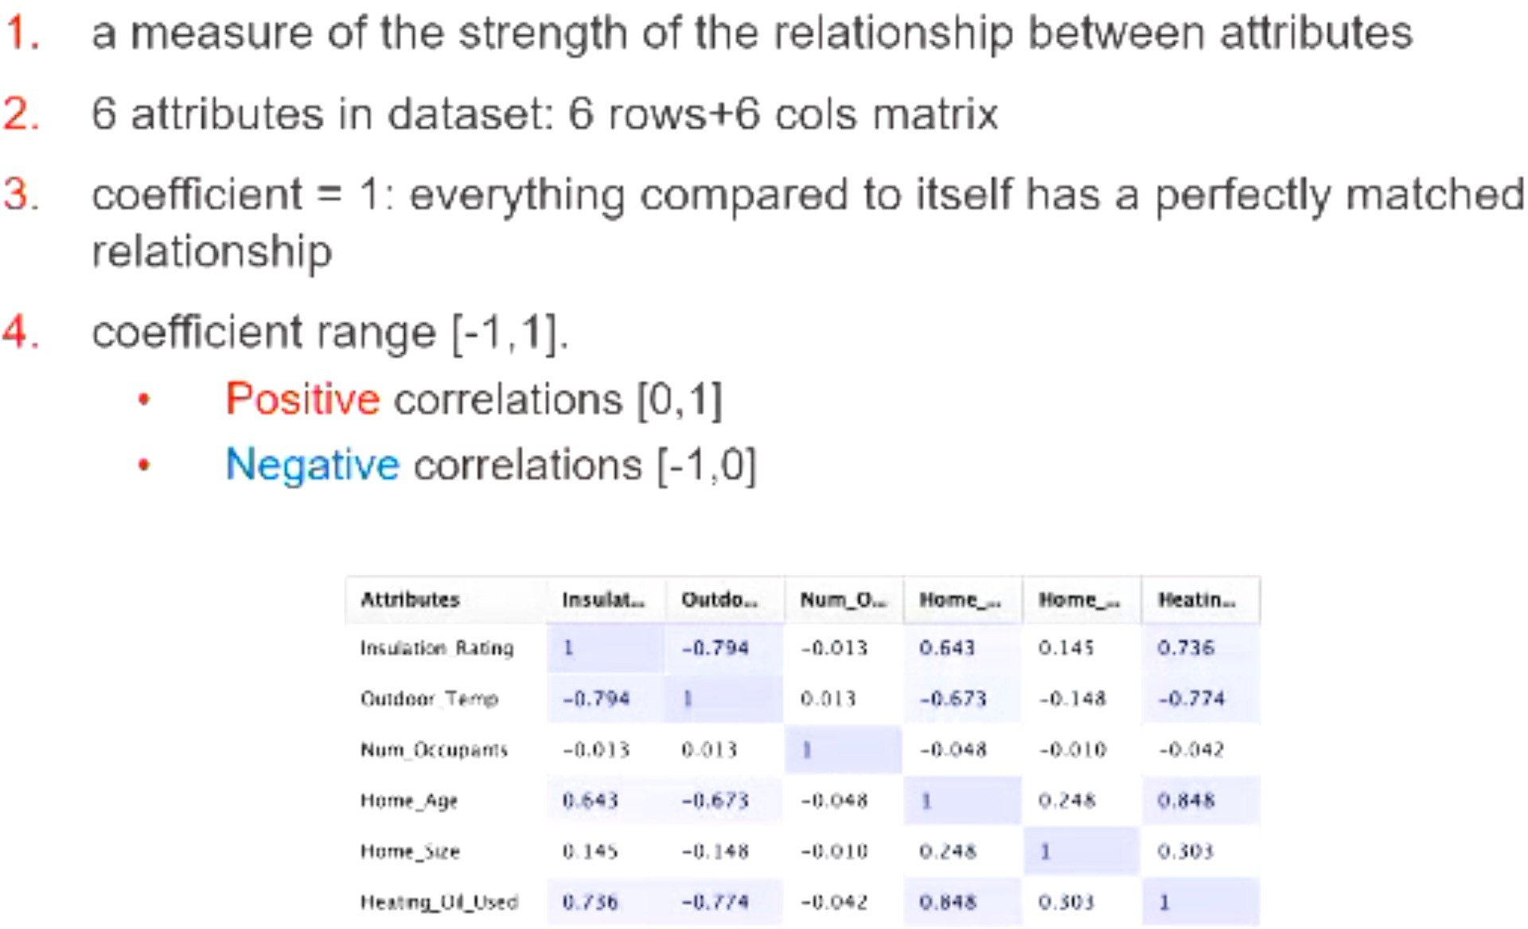
Analysis on Correlation Coefficients

Slide 83
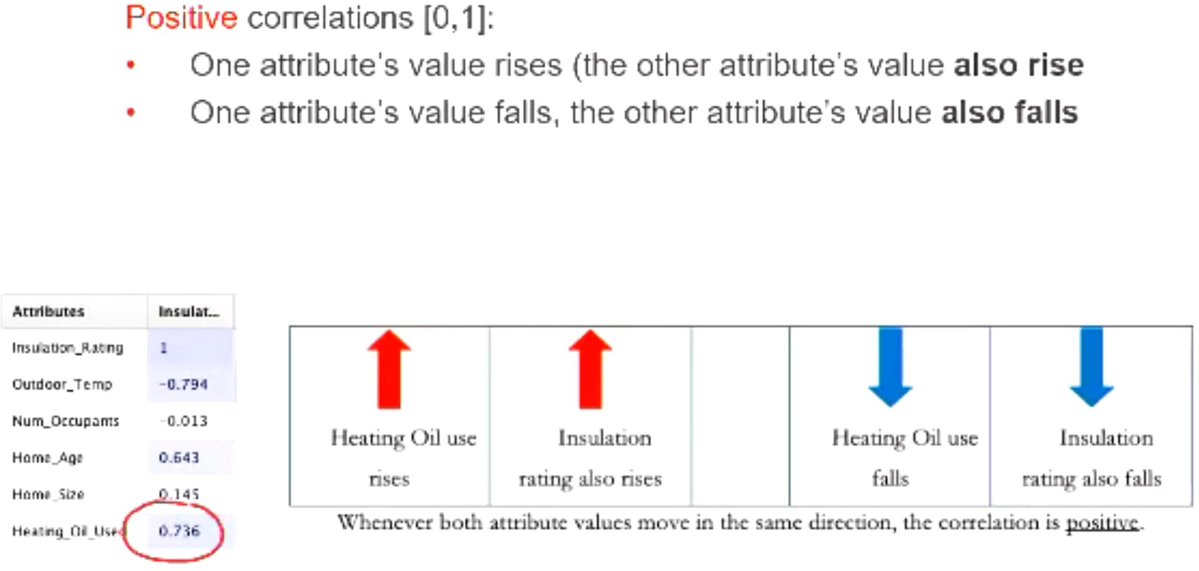
Positive Correlation Coefficients
Evaluation

Slide 84
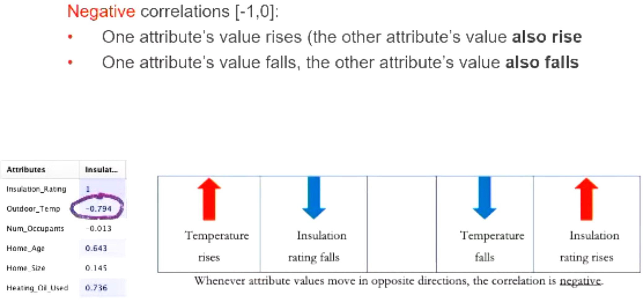
Negative Correlation Coefficients
Evaluation

Slide 85
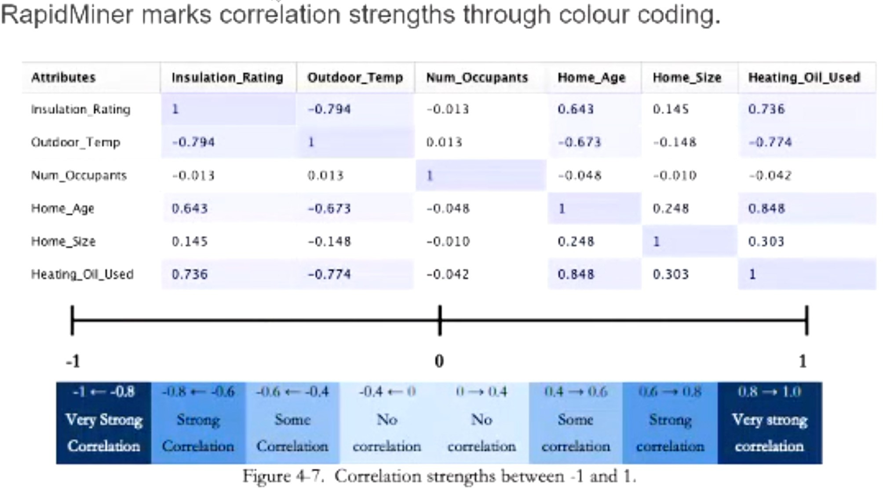
Correlation Strengths between -1 and 1
Evaluation

Slide 86
Some important points
These are only general guidelines and not hard-and-fast rules; a correlation coefficient of .2 does show interaction between attributes, even if it is not statistically significant.
Correlation does not prove causation, and this assumption can be dangerous and often false
Confessions are not percentages; the underlying mathematical formula to calculate solely measures the strength

Slide 87
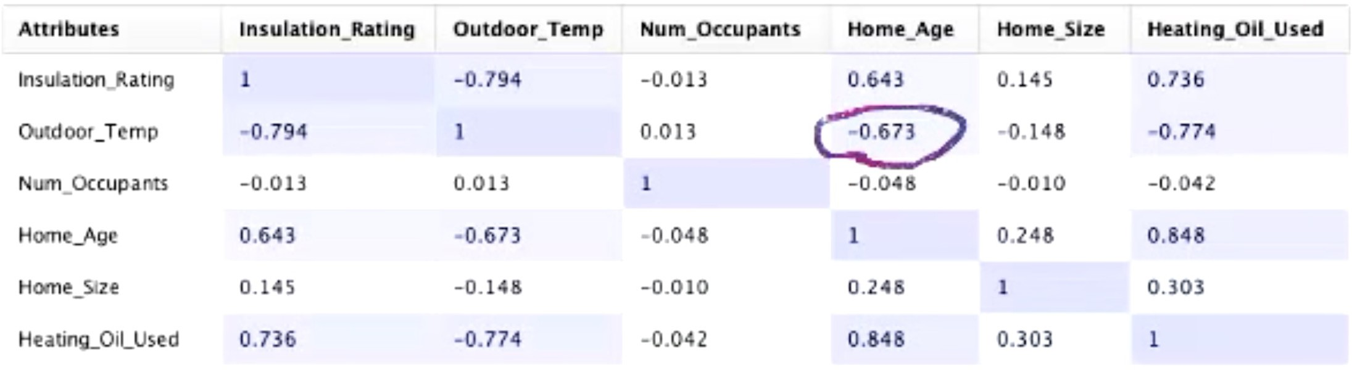
Example
Correlation does not prove causation, and this assumption can be dangerous and often false
Could the average age of the home have any effect on that home's average yearly outdoor temperature?
Certainly not

Slide 88
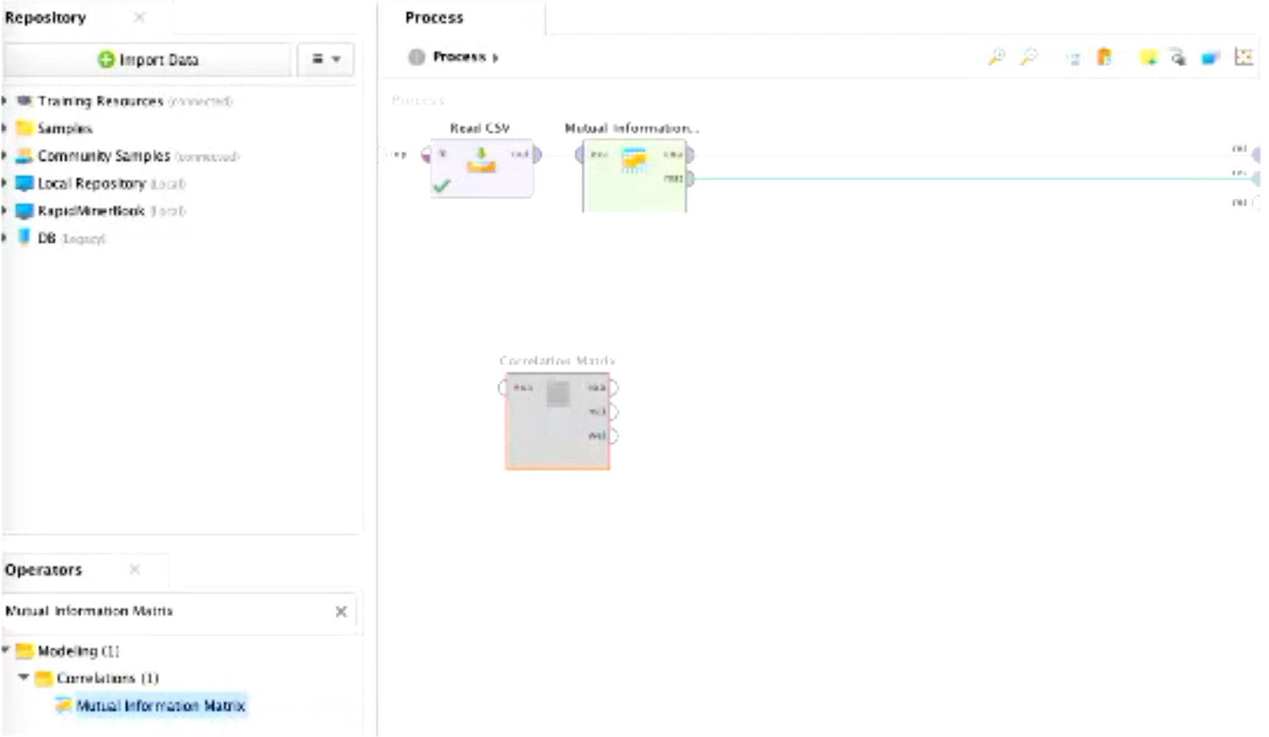
Change the Model to use mutual information matrix
Alternative Correlation Method

Slide 89
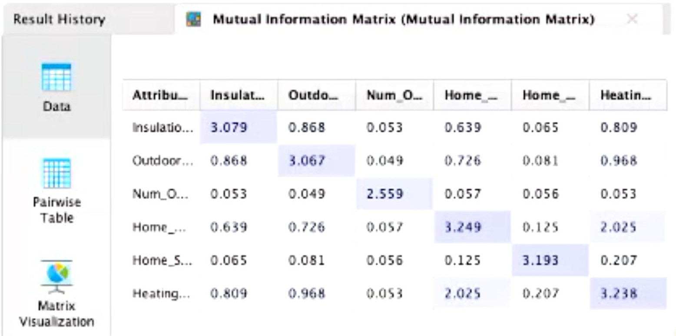
The larger, the number, the stronger the relationship
Cannot determine the direction of the relationship
More appropriate when attributes are only going to move together in the same direction (positively correlated)

Slide 90
Deployment
Deployment, doing something with what you have learned from your model, or taking some action based on what your model tells you
CRISP-DM is a cyclical process - may need to repeat analysis
Reducing attributes
Adding greater granularity
Adding additional attributes
May also investigate the role of attributes for greater insight into the results

Slide 91

Association Rules

Slide 92
Association Rules
Chapter 5 (73-87)
What are Association Rules?
Association rules are a data mining technique used to find relationships between different items in a dataset.
The goal is to discover frequent patterns that help understand which items often appear together.

Slide 93
Examples of Association Rules in Real Life
Scenario | Explanation
Shopping Basket Analysis | Retailers analyze purchases to see which products are bought together (e.g., bread & butter, chips & soft drinks).
Amazon Recommendations | When you buy a smartphone, Amazon suggests screen protectors and chargers based on frequent purchases.

Slide 94
Examples of Association Rules in Real Life
Scenario | Explanation
Supermarkets (Australia-Specific) | Woolworths and Coles use association rules to offer discounts on related items (e.g., pasta & pasta sauce).
Netflix & Spotify | These platforms recommend movies/songs based on what users with similar preferences watched or listened to.

Slide 95
Key Measures in Association Rules
Measure | Definition | Example
Support | How often a set of items appears in the dataset. | 20% of customers buy milk and bread together.
Confidence | Given that one item is bought, how often the second item is bought. | 70% of customers who buy a smartphone also buy a case.
Lift | How much more likely two items are bought together compared to chance. | Lift = 2 means customers are twice as likely to buy both items together than randomly.

Slide 96
Why Does It Matter?
Helps businesses increase sales by understanding customer behavior.
Improves product recommendations (Amazon, Netflix, Spotify).
Supports marketing strategies (e.g., bundle deals, personalized offers).

Slide 97
Understanding Frequency Patterns in Data Mining
What is a Frequency Pattern?
A pattern that appears frequently in a dataset.
Used in association rule mining to find relationships between data points.
Example: Shopping Basket Analysis – if many customers buy bread and butter together, it forms a frequent pattern.

Slide 98
Understanding Frequency Patterns in Data Mining
Confidence Percent vs. Support Percent
Metric | Definition | Formula | Example
Support | How often a rule appears in the dataset | (Occurrences of A & B) / (Total transactions) | If 3 out of 10 people buy both cookies & milk, support = 3/10 = 30%

Slide 99
Understanding Frequency Patterns in Data Mining
Confidence Percent vs. Support Percent
Metric | Definition | Formula | Example
Confidence | How likely B is to be bought when A is bought | (Occurrences of A & B) / (Occurrences of A) | If 4 people buy cookies and 3 of them also buy milk, confidence = 3/4 = 75%

Slide 100
Understanding Frequency Patterns in Data Mining
Why Do These Metrics Matter?
Higher Support = A pattern appears frequently, making it valuable.
Higher Confidence = A rule is reliable for predicting future behavior.
Used in marketing, recommendation systems, and business decisions.

Slide 101
Understanding Frequency Patterns in Data Mining
Real-World Example (Australia)
Woolworths studies purchases and finds:
If a customer buys Vegemite, they also buy bread 80% of the time (High Confidence).
But only 10% of total transactions include both (Low Support).
Woolworths can offer a combo deal to increase sales.

Slide 102
Understanding Frequency Patterns in Data Mining
Research Discussion Question:
Can you think of another example where support is low, but confidence is high? How can businesses use this?

Slide 103
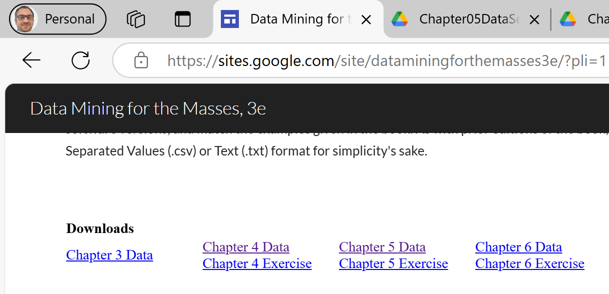
Rapid-Miner Problem-Solving Question:
Scenario: You are a data analyst studying community engagement in different organizations. Your goal is to find patterns and associations between different types of memberships (e.g., family, hobbies, social clubs, political groups, etc.).
Using association rule mining, analyze the dataset and answer the following:

Slide 104
Rapid-Miner Problem-Solving Question:
Which types of organizations frequently appear together?
What is the most confident association rule in the dataset?
Identify any outliers using standard deviation and explain their potential impact.

Slide 105
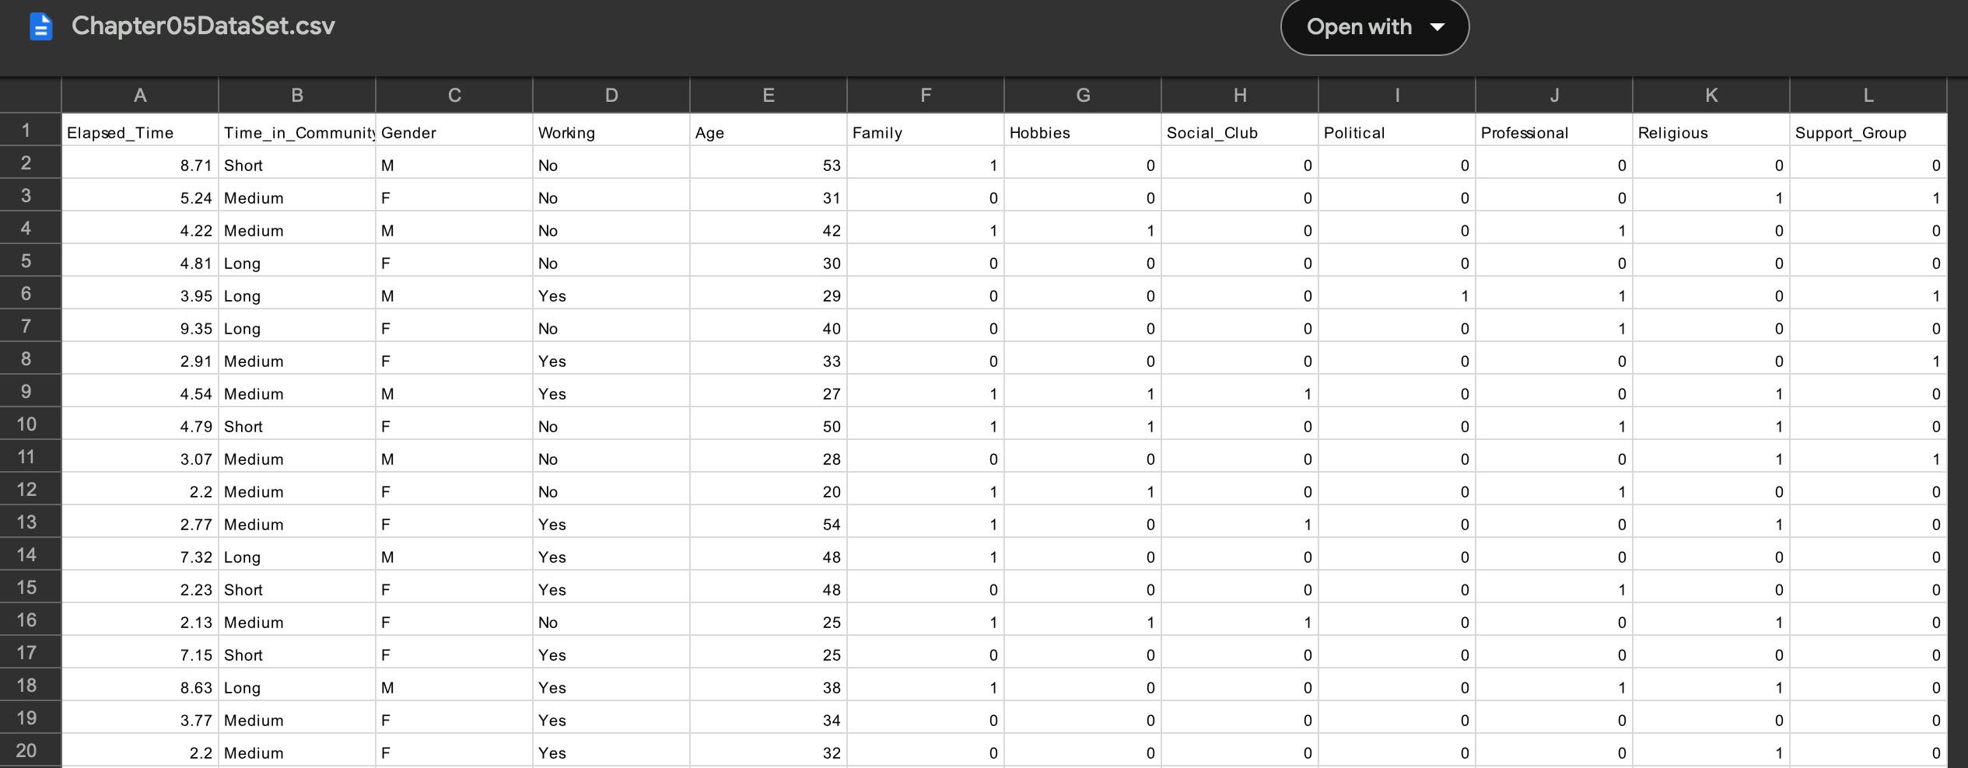
Rapid-Miner Problem-Solving Question:

Slide 106
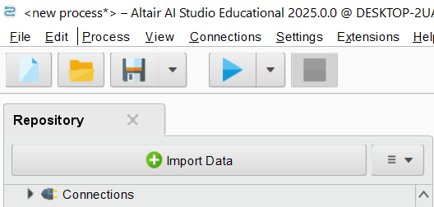
1. Load the Dataset
Download the dataset from this link
Save it to your local computer (you cannot directly import from a URL in RapidMiner)
Open RapidMiner Studio
Click Import Data and select the CSV file
Use the Read CSV operator in a new process

Slide 107
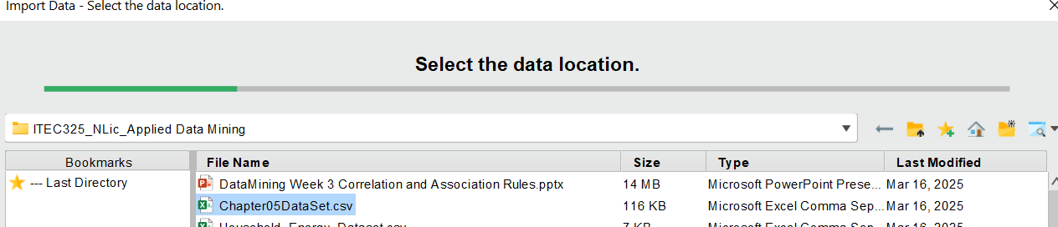
1. Load the Dataset
Download the dataset from this link
Save it to your local computer (you cannot directly import from a URL in RapidMiner)
Open RapidMiner Studio
Click Import Data and select the CSV file
Enter Path & Use the Read CSV operator in a new process

Slide 108
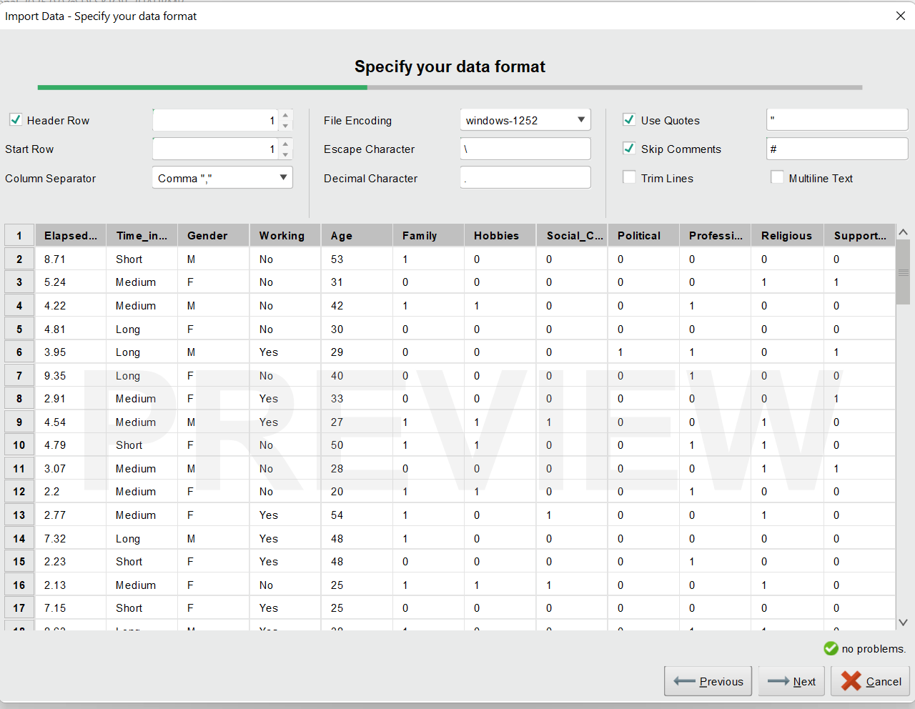
Configure:
Column separator: Comma (,)
Use first row as headers: Yes
Data types: Ensure categorical variables are binominal

Slide 109

Where to Store?
Select Path and Name
Click on Finish

Slide 110

2. Show Basic Statistics
After importing, run the process to inspect the dataset
Use the Statistics tab to check:
Minimum and Maximum Values
Mean and Standard Deviation for numerical attributes (e.g., Age, Elapsed_Time)
Distribution of categories (e.g., Gender, Working status)

Slide 111
Key Findings from the Dataset
Numerical Attributes
Interpretation:
Some people finished the survey very quickly (2 min), while others took up to 10 min.
The average age is around 36 years, meaning most respondents are middle-aged.
Attribute | Min | Max | Average (Mean)
Elapsed_Time (survey completion time) | 2.01 min | 10.15 min | 5.92 min
Age (respondent’s age) | 17 years | 57 years | 36.73 years

Slide 112
Categorical Attributes
Interpretation:
Most respondents have lived in the community for a long time.
The dataset is balanced in gender distribution.
Nearly half of the respondents are employed.
Attribute | Most Common Value | Least Common Value
Time_in_Community | Long (1,465 respondents) | Short (714 respondents)
Gender | Female (1,790 respondents) | Male (1,693 respondents)
Working Status | Yes (1,744 respondents) | No (1,739 respondents)

Slide 113
Binary Attributes (Participation in Groups)
Interpretation:
About 39% of respondents participate in family-oriented activities.
Only 18.8% of people are involved in social clubs, which is the least common category.
Attribute | Mean (Participation Rate) | Min (Not in Group) | Max (In Group)
Family | 0.390 (39%) | 0 | 1
Hobbies | 0.300 (30%) | 0 | 1
Social Club | 0.188 (18.8%) | 0 | 1

Slide 114
3. Why is This Important?
Spotting Trends → We can see which groups are most and least popular.
Understanding Community Engagement → Helps policymakers or researchers see which organizations attract the most people.
Preparing for Data Analysis → These statistics help us decide what to explore further in association rule mining.

Slide 115
FP-Growth & Association Rule Mining
1. Data Preparation
Before running FP-Growth, the dataset needs to be cleaned and structured properly.
1.1 Import Dataset
Click "Import Data" in the Repository panel.
Choose "Chapter05DataSet.csv" (already uploaded).
Use the Read CSV operator to load the dataset.

Slide 116


Steps:
Search for the "Numerical to Binominal" Operator:
In the "Operators" panel, search for Numerical to Binominal.
Drag and drop it into your process workflow.
Connect to Data:
Connect the Read CSV (or Retrieve Data) output to Numerical to Binominal.
Set Parameters:
Attribute Filter Type → All (or manually choose specific attributes like Family, Hobbies, Political, etc.).
Ensure:
Min Value = 0
Max Value = 1

Slide 117

Run the Process:
Click Run and check the Results tab.
The column type should now be Binominal instead of Integer.
Verify this change in the Statistics or Results section.

Slide 118
The results will be binomial

Slide 119
3. Selecting Relevant Attributes
Goal: FP-Growth works best with a reduced dataset, focusing only on categorical attributes.
Steps:
Search for "Select Attributes" Operator.
Drag it into the workflow and connect it after "Numerical to Binominal."

Slide 120

3. Set Parameters:
Attribute Filter Type → Subset.
Select only the relevant columns: Family, Hobbies, Social_Club, Political, Professional, Religious, Support_Group.
4. Run the Process and check the dataset to confirm attribute selection.

Slide 121

FP-Growth & Association Rule Mining
Results (reduced dataset)

Slide 122
FP-Growth & Association Rule Mining
4. Running FP-Growth (Finding Frequent Patterns)
Goal: Identify common relationships among attributes.
Steps:
Search for "FP-Growth".
Drag and drop FP-Growth into the process.
Connect it to the Select Attributes output.
Set Parameters:

Slide 123
FP-Growth & Association Rule Mining
Suggested FP-Growth Parameter Settings:
Parameter | Suggested Value | Explanation
Min Support | 0.05 (5%) | Frequent itemsets should appear in at least 5% of the data (174 instances out of 3,483). Adjust based on the dataset sparsity.
Min Items per Itemset | 1 | Consider individual attributes before forming larger patterns.

Slide 124
FP-Growth & Association Rule Mining
Suggested FP-Growth Parameter Settings:
Parameter | Suggested Value | Explanation
Max Items per Itemset | 3 | Limit patterns to a combination of up to 3 attributes to keep results interpretable.
Max Number of Itemsets | 5000 | Ensures the process doesn't generate an overwhelming number of frequent itemsets.

Slide 125
FP-Growth & Association Rule Mining
Suggested FP-Growth Parameter Settings:
Parameter | Suggested Value | Explanation
Min Number of Itemsets | 1 | Ensures at least one pattern is generated.
Decrease Factor | 0.7 | Gradually lowers support threshold in case no patterns are found initially.

Slide 126
FP-Growth & Association Rule Mining
Run the Process and view frequent itemsets.
Expected Outcome:
{Religious, Family} → Appears in 12% of the dataset
{Professional, Hobbies, Support_Group} → Appears in 8%
These results will help in Association Rule Mining if you decide to proceed further.

Slide 127

FP-Growth & Association Rule Mining
Alternative Way is to use Python:
Remove Unnecessary Operators
Keep only Retrieve Data and Execute Python

Slide 128
FP-Growth & Association Rule Mining
Connect the dataset to Execute Python
Link Retrieve Chapter05DataSet → Execute Python.
Then, link Execute Python → Output.
Because of License requirement for this operator, we can only write Python Code.

Slide 129


FP-Growth & Association Rule Mining
pip install pandas mlxtend
It will generate csv files

Slide 130

FP-Growth & Association Rule Mining
Frequent Itemsets:
The most common category in the dataset is Political_0, appearing in about 90.6% of the data. This means many people are not associated with political groups. Similarly, Support_Group_0 and Social_Club_0 are also common, meaning a large number of people are not engaged in these activities. This pattern helps us understand general interests and behaviors in the dataset.

Slide 131
FP-Growth & Association Rule Mining
Association Rules:
The association rules tell us how one category is related to another. For example, the rule Political_0 → Support_Group_0 has a confidence of 86.3%, meaning that if someone is not involved in politics, there is an 86% chance they are also not in a support group. The lift value (~1.02) suggests a very weak relationship—this rule is slightly better than random guessing.

Slide 132
FP-Growth & Association Rule Mining
Association Rules:
Similarly, Social_Club_0 → Political_0 has 91.2% confidence, meaning if someone is not part of a social club, they are also very likely not involved in politics. However, the low lift values indicate that these relationships are not very strong.

Slide 133
FP-Growth & Association Rule Mining
Key Takeaways:
Most people in the dataset are not part of political, social, or support groups.
There is some weak correlation between these categories—if a person is missing from one group, they are also likely to be missing from another.
Confidence is high, but lift is low, meaning these patterns exist but are not necessarily meaningful for decision-making.

Slide 134
Thank You
Have a Great Learning Day!
Feel free to reach out with any questions!

